Slide 1
Guatemala – Mike (July) Philippines – Shelley & Paul (May) Gensend – Susan (June – July)
ROOTs Remember the Poor 2019
Notes:
1. Pick one or more of these themes to talk to ROOTS about. Number them 1, 2, 3 in importance to you (tell Paul and Shelley which one(s) you want to do)
~ preparation for the trip, and fund-raising, Devo, etc
~ the local church/organization, how you interacted with them, encouraged them
~ the leaders and members you worked with
~ individuals you've met
~ team dynamics
~ activities
~ stories of people you've met, or things you've experienced
~ observing the life of a missionary, church planters- sacrifices, diligence, focus on gospel, courage
We'll collate your picks and let you know which one(s) you'll do. That will give you time to start preparing your talk.
(choose 3 or 4 photos, perhaps a video, that go with the theme you've picked - send them to Paul and Shelley)
2. Prepare a personal testimony about the Project (pick some of these to frame your report - don't have to include all)
~ what your expectations were, before going
~ a person you met who impacted you
~ an incident/story that impacted you
~ why you're glad you went, how you were stretched, etc
~ why ROOTS should be doing more "Remember the Poor" Projects
(choose an extra photo if you wish, for this part of the presentation, and send them to Paul and Shelley)

Slide 2
Guatemala
Short Term Missions Trip
through Impact Ministries
Notes:
1. Pick one or more of these themes to talk to ROOTS about. Number them 1, 2, 3 in importance to you (tell Paul and Shelley which one(s) you want to do)
~ preparation for the trip, and fund-raising, Devo, etc
~ the local church/organization, how you interacted with them, encouraged them
~ the leaders and members you worked with
~ individuals you've met
~ team dynamics
~ activities
~ stories of people you've met, or things you've experienced
~ observing the life of a missionary, church planters- sacrifices, diligence, focus on gospel, courage
We'll collate your picks and let you know which one(s) you'll do. That will give you time to start preparing your talk.
(choose 3 or 4 photos, perhaps a video, that go with the theme you've picked - send them to Paul and Shelley)
2. Prepare a personal testimony about the Project (pick some of these to frame your report - don't have to include all)
~ what your expectations were, before going
~ a person you met who impacted you
~ an incident/story that impacted you
~ why you're glad you went, how you were stretched, etc
~ why ROOTS should be doing more "Remember the Poor" Projects
(choose an extra photo if you wish, for this part of the presentation, and send them to Paul and Shelley)

Slide 3
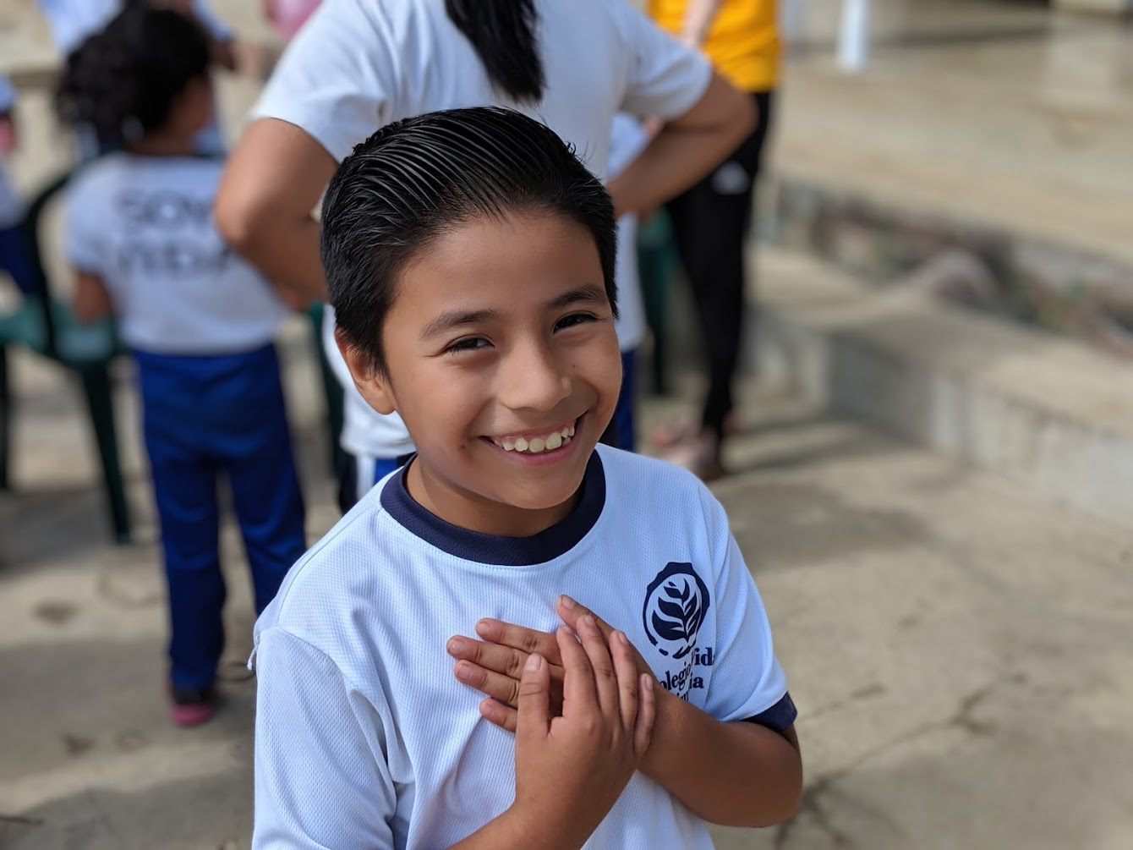
Table of contents
About Impact Ministries
Highlights of Impact
The Experience
Spiritual
Cultural
Overall
Story
Reflection
Why should we go

Slide 4
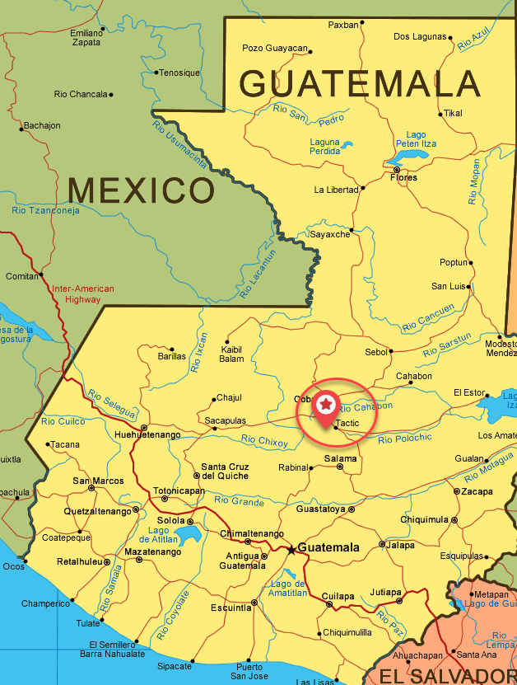
About Impact ministries
Who – Canadians and Guatemalans working together to grow Godly leaders.
What – The Bible provides the principle foundation
When – Operating in Guatemala since 2000
Where – Rural countryside of Tactic
Why – More than 75% of indigenous people live in poverty
Notes:
A key item driving poverty is the lack of education. Average person in Tactic has 4.25yrs of education. Without education these people will continue to do labour jobs that pay less than minimum wage. Guatemalans are hard working people. The idea of adolescent does not happen in Guatemala, because everyone in the family has a role to play and everybody has a job to do. If they do not do the work, then that task does not happen, so at a young age kids are taught that they have a part to play in helping the bigger picture. This is why kids as young as 6yrs old are taught that they need to contribute in helping the family earn money to support the family, and neglect their education. As a result Impact Ministries are trying to provide a better living for these communities, educating people that God does not want you to live in these poor standards
Impact Ministries saw a need to help these families to continue education and develop
Kid would go work at butcher shops, carry wood, pick tomatoes, take care of siblings while parents
In Guatemala, Laws are only a suggestion.

Slide 5
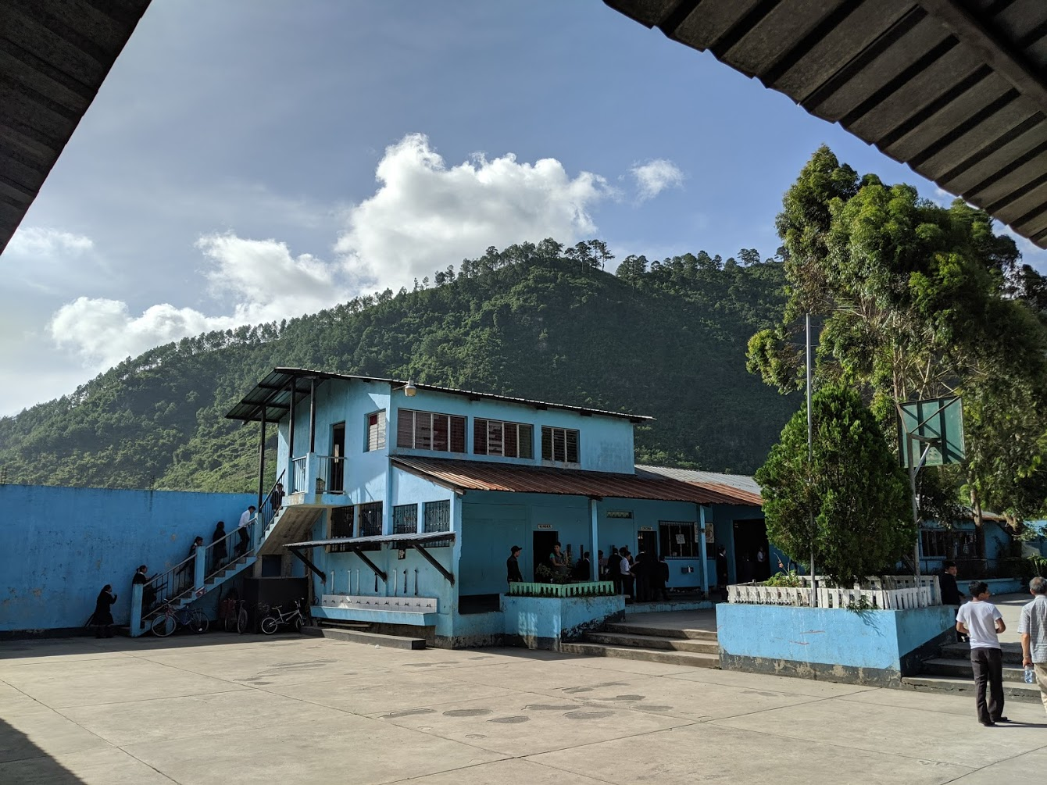
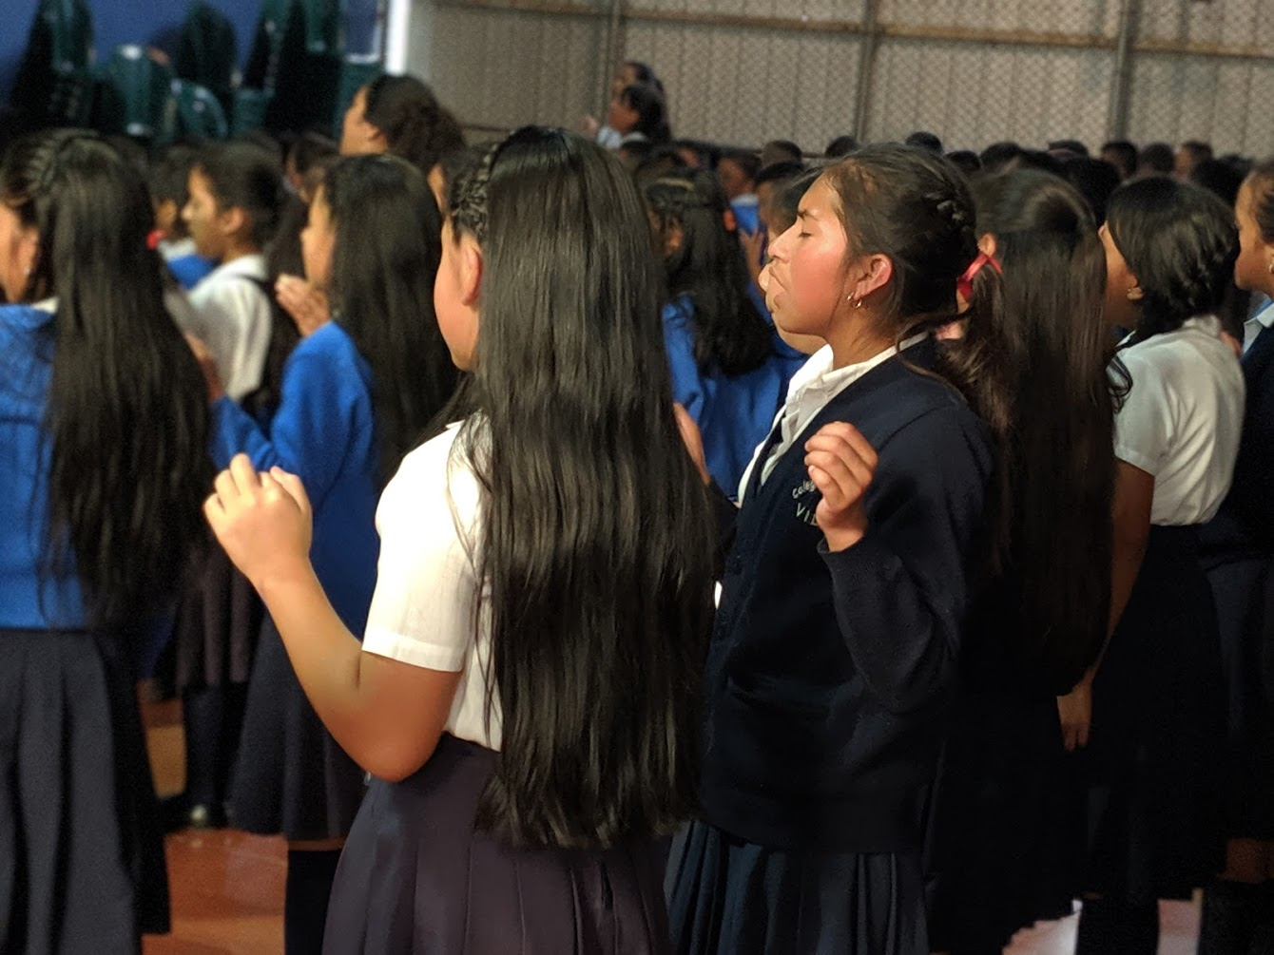
Highlights
Schools - 10 schools supporting +1,500 students
- Many Christian teachers were students themselves
Church - 3 congregations with various programs
Medical and Dental Clinics - set up at the schools
Orphan Care – 2yr application has been approved!
- First baby arrived on the week of July 16th
Notes:
Schools
In the rural areas around Tactic, more than 80 percent of the adults are illiterate, leaving them disenfranchised and isolated. Many parents don’t understand the value of education and prefer to put their children to work, to help earn money to sustain the family. Often these children have never held a pencil or crayon in their hand.
There are

Slide 6
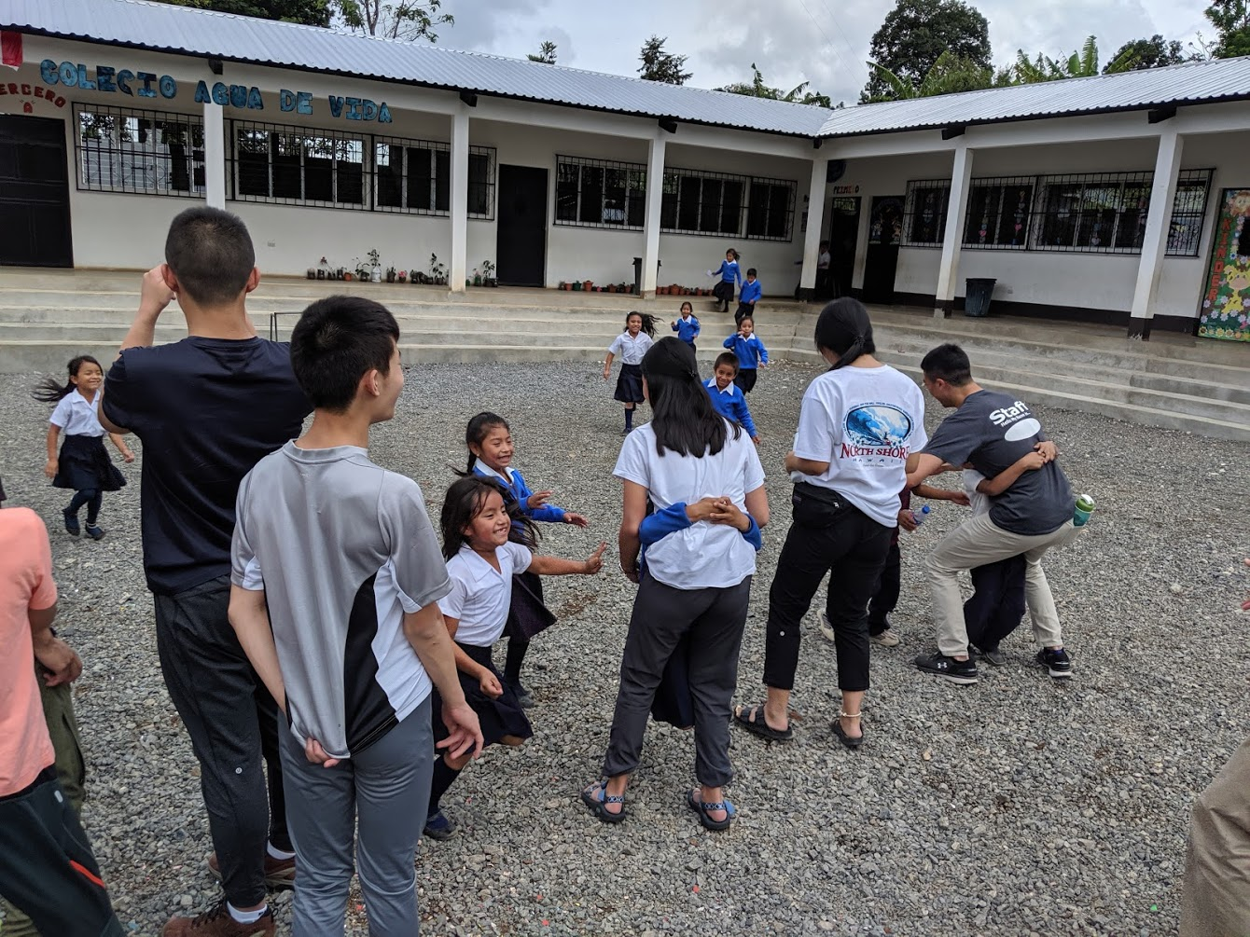
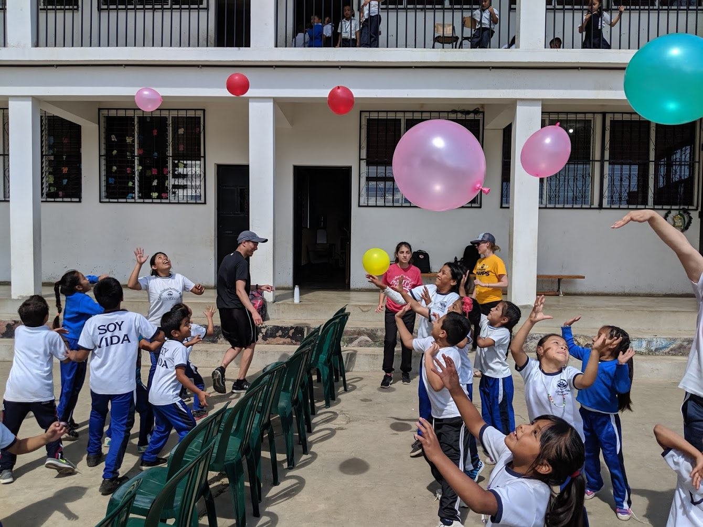
The Experience (spiritual)
Visited numerous schools and classes
Hosted Vacation Bible School (VBS)
Hospital and Home Visitation
Work Project
Prayer Meeting
Notes:
In the way we show love, we hope kids aer going to sleep and remembering how the missionaries behaved and how they want to proceed in their walk with Christ.
Like in Asia, teachers are highly regarded in Guatemala as they help shape the minds of the next generation

Slide 7
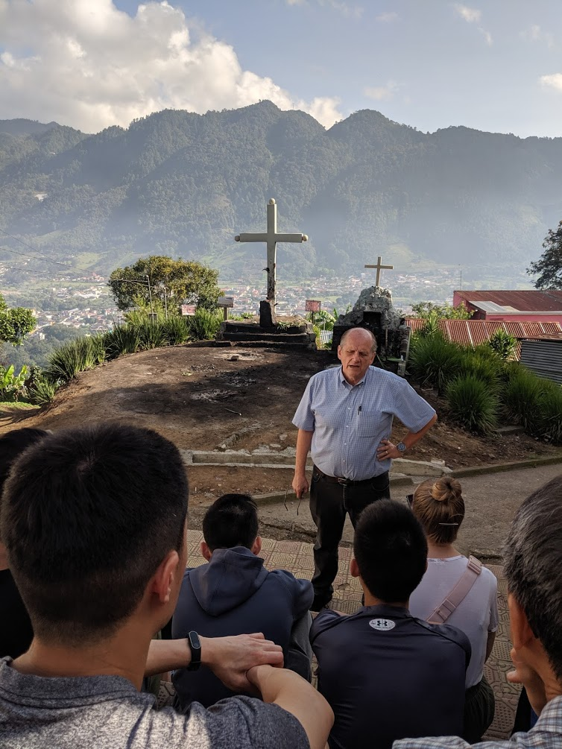
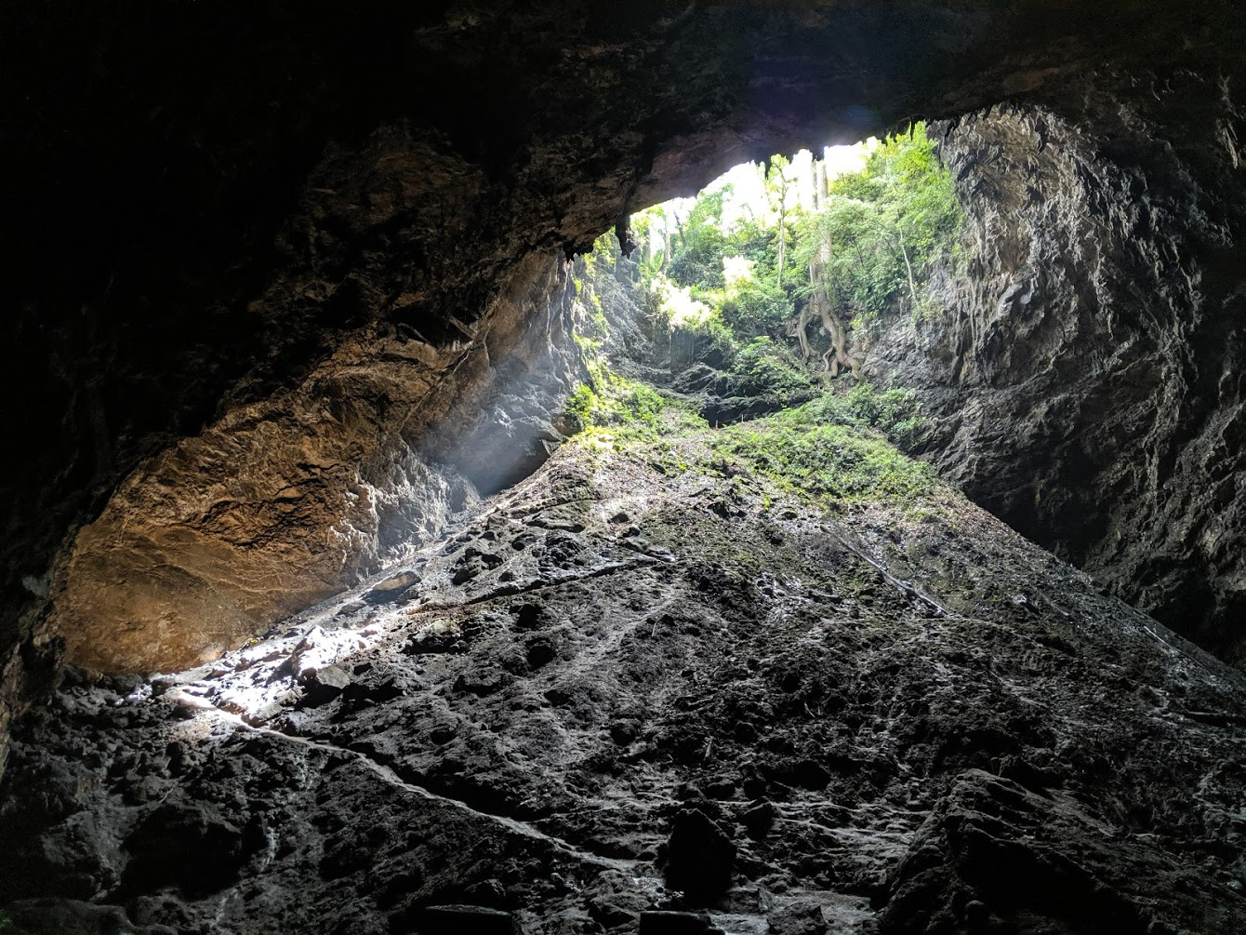
The Experience (Cultural)
History
Visited Numerous Landmarks
Market Activity
Cultural Night and Experience
Notes:
History
Historical accounts of how Guatemala is how it is today
Synchronism (example: The Catholic church encouraged the interweaving of Mayan and Catholic religions to make it more appealing for the locals to adapt Catholicism)
Visited numerous landmarks
Parliament building
Sinkhole (where Mayan witch doctors preform rituals to seek assistance from the Underworld) – do not be intimidated by this as Christ is in us and we are his ambassadors.
Visited Chixim (a Catholic church that mixes the Mayan Corn God with Catholicism)
Market Activity
An opportunity to complete a checklist of items with a limited amount of cash at the local market
Cultural Night and Experience
A day in the live of a Guatemalan Man or Woman.
Shared discussions with the Guatemalan teachers to hear each other’s history and story

Slide 8
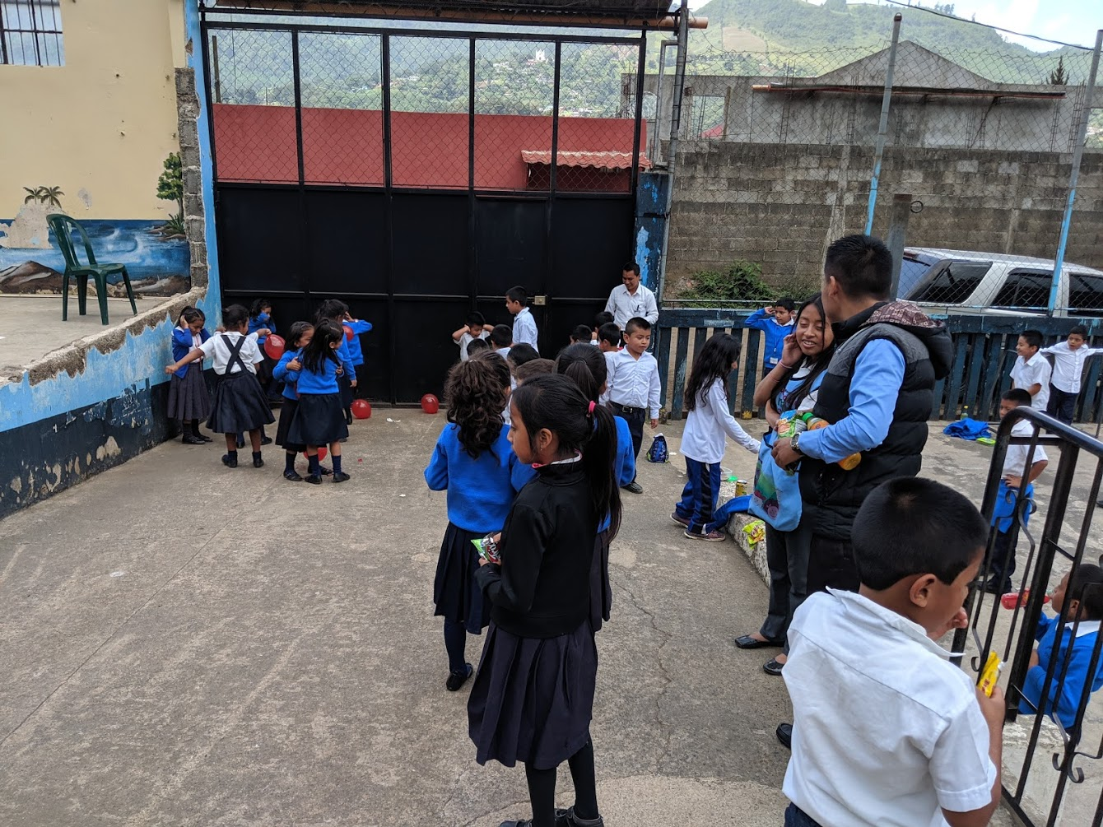
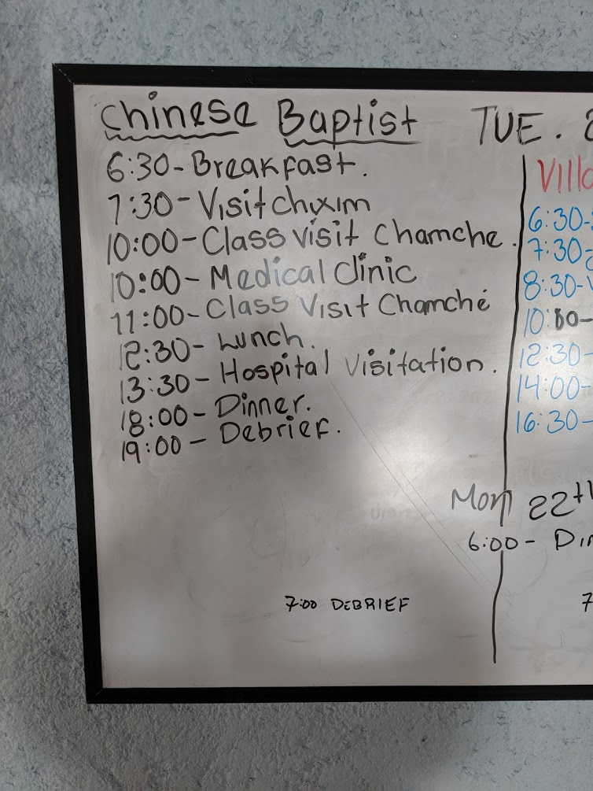
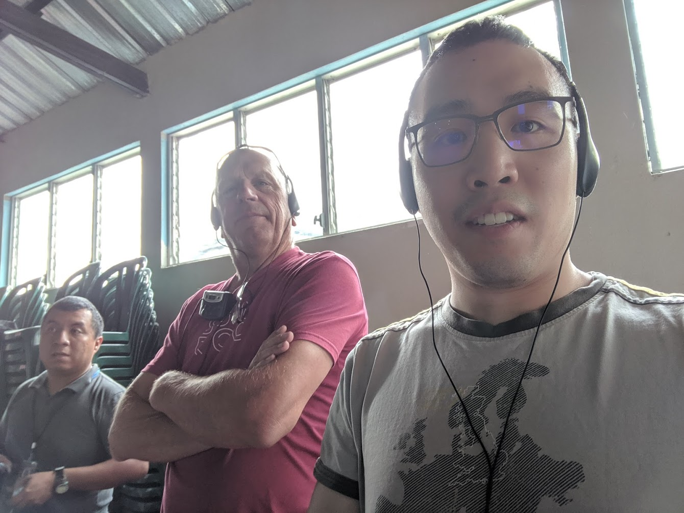
The Experience (Overall)
Safe
English translation was easily accessible
Well organized

Slide 9
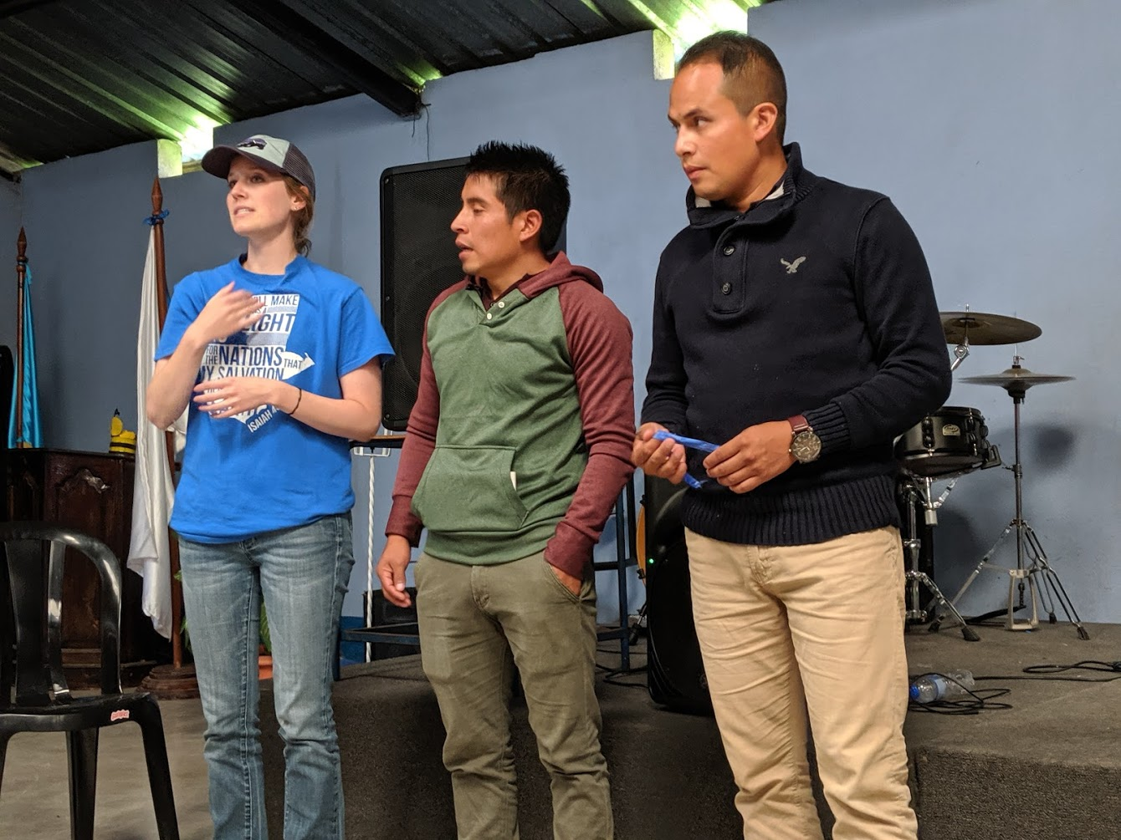
Story – faithfulness has no age
The school at Mocohán has a water issue. Its only source of water was from a contaminated well.
Notes:
We met with the principle at the school of Mocohan (pronounced: Mac-qwon), he told us a story of faith…
Currently there is a water constraint at the school as the current water well does not provide enough water to support the growing community. Furthermore, the well water is contaminated which caused the kids to get sick. The principle gathered all the teachers and discussed how could they resolve this problem. A student overheard their discussion and commented, that why don’t we pray for it? They did.. And within a week a large downpour of rain lasting many days, after of which, a previously dried river bed around the school was filled providing an alternative water source. A blessing!
Sometimes the kids think the elders are teaching them, but in fact the kids are teaching us. What faith!

Slide 10
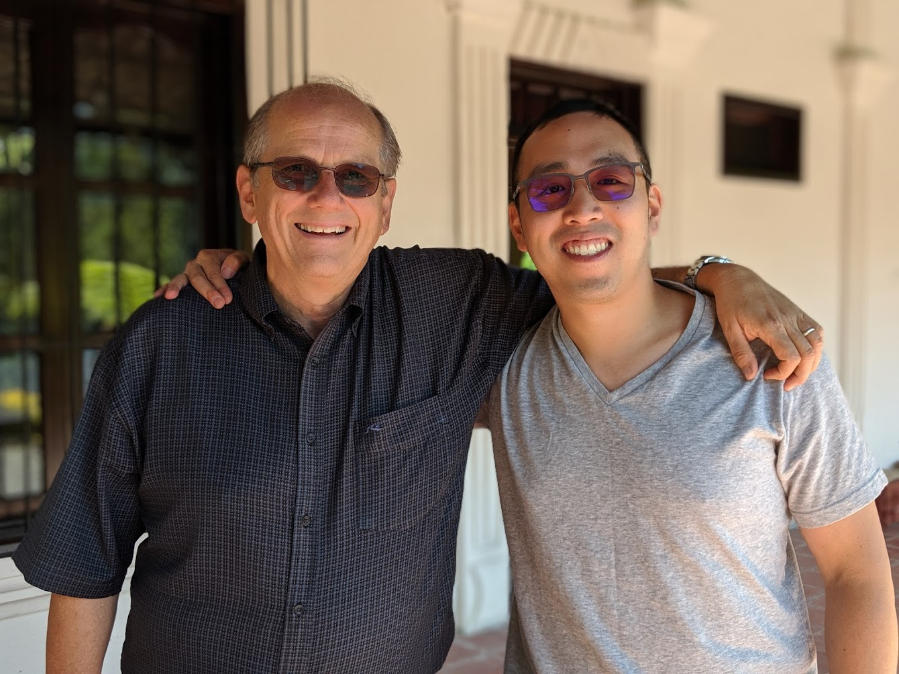
Reflection
How are we promoting God’s Culture?
Does our abundance in Canada hinder our walk with God?
God won’t ask you to do something impossible, only what seems impossible
Notes:
Reflection

Slide 11
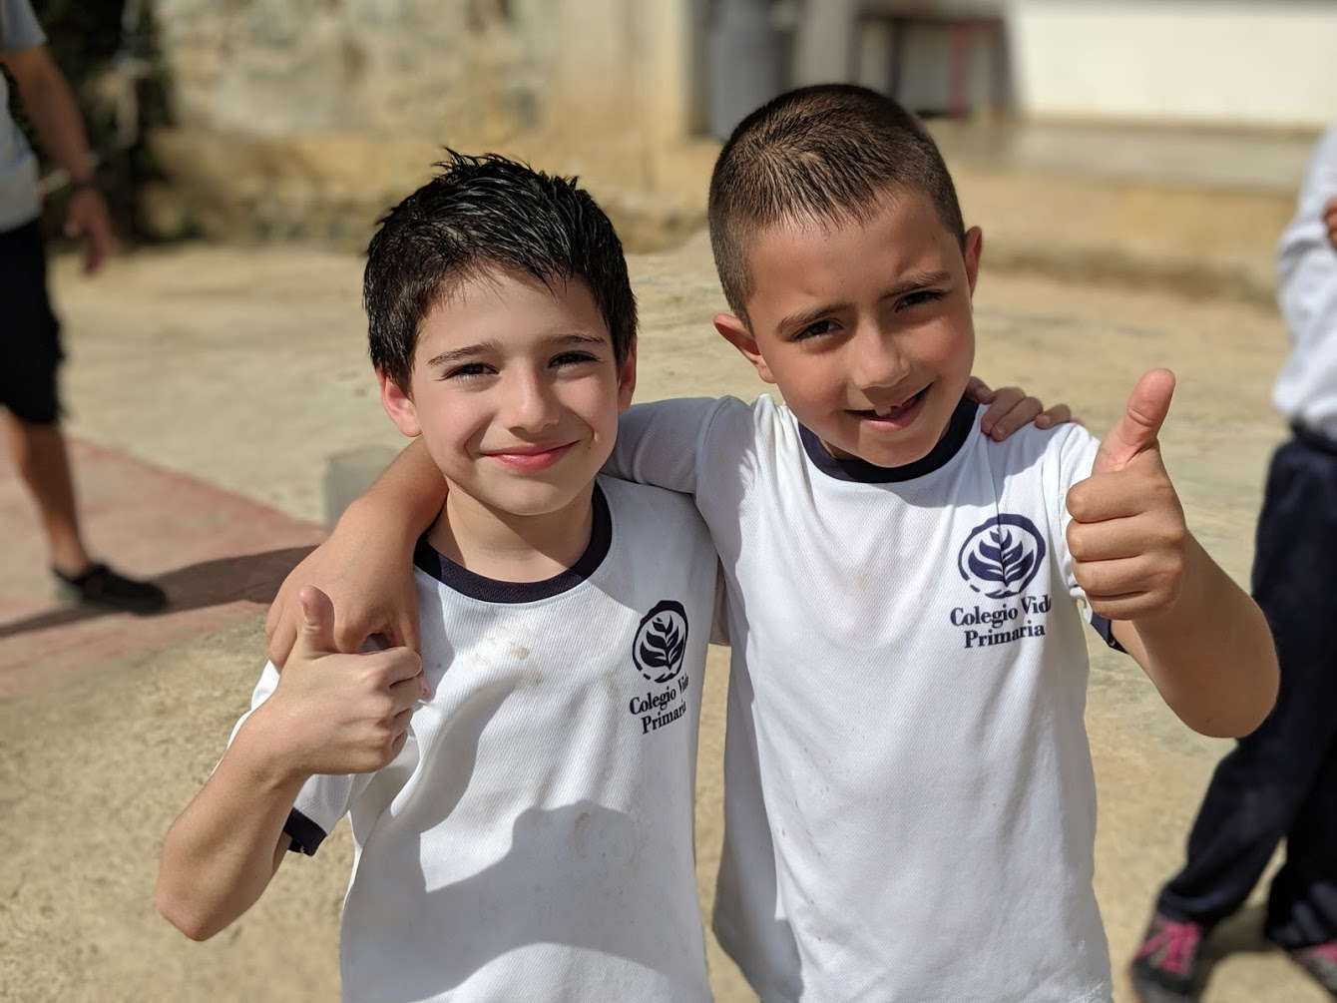
Why should go
Witness the miracle of what God is doing in Guatemala
Step out of our routine and our comfort zone and let God give you an experience
Vancouver Christian Baptist Church (VCBC) will be going in July 28 to August 7, 2020

Slide 12
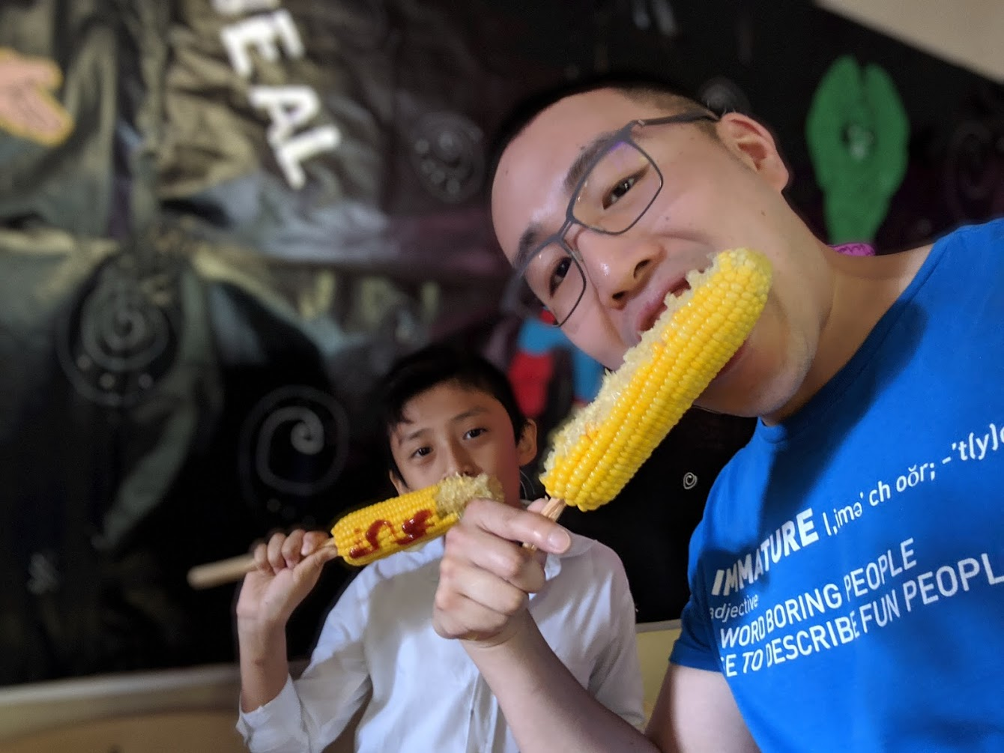
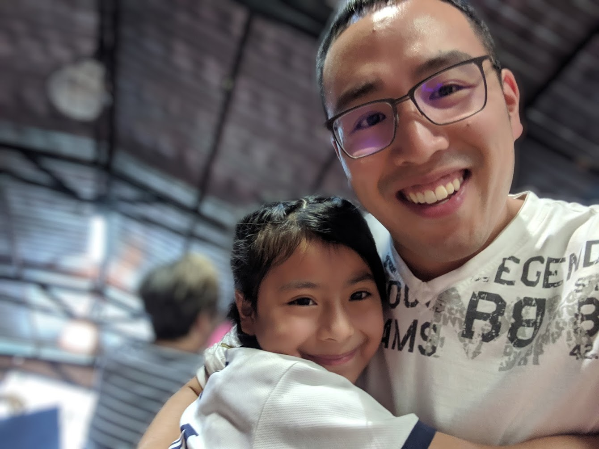
Dios los bendiga! – God Bless you!

Slide 13
ROOTS Remember the Poor 2019 Philippines Missions Trip

Slide 14
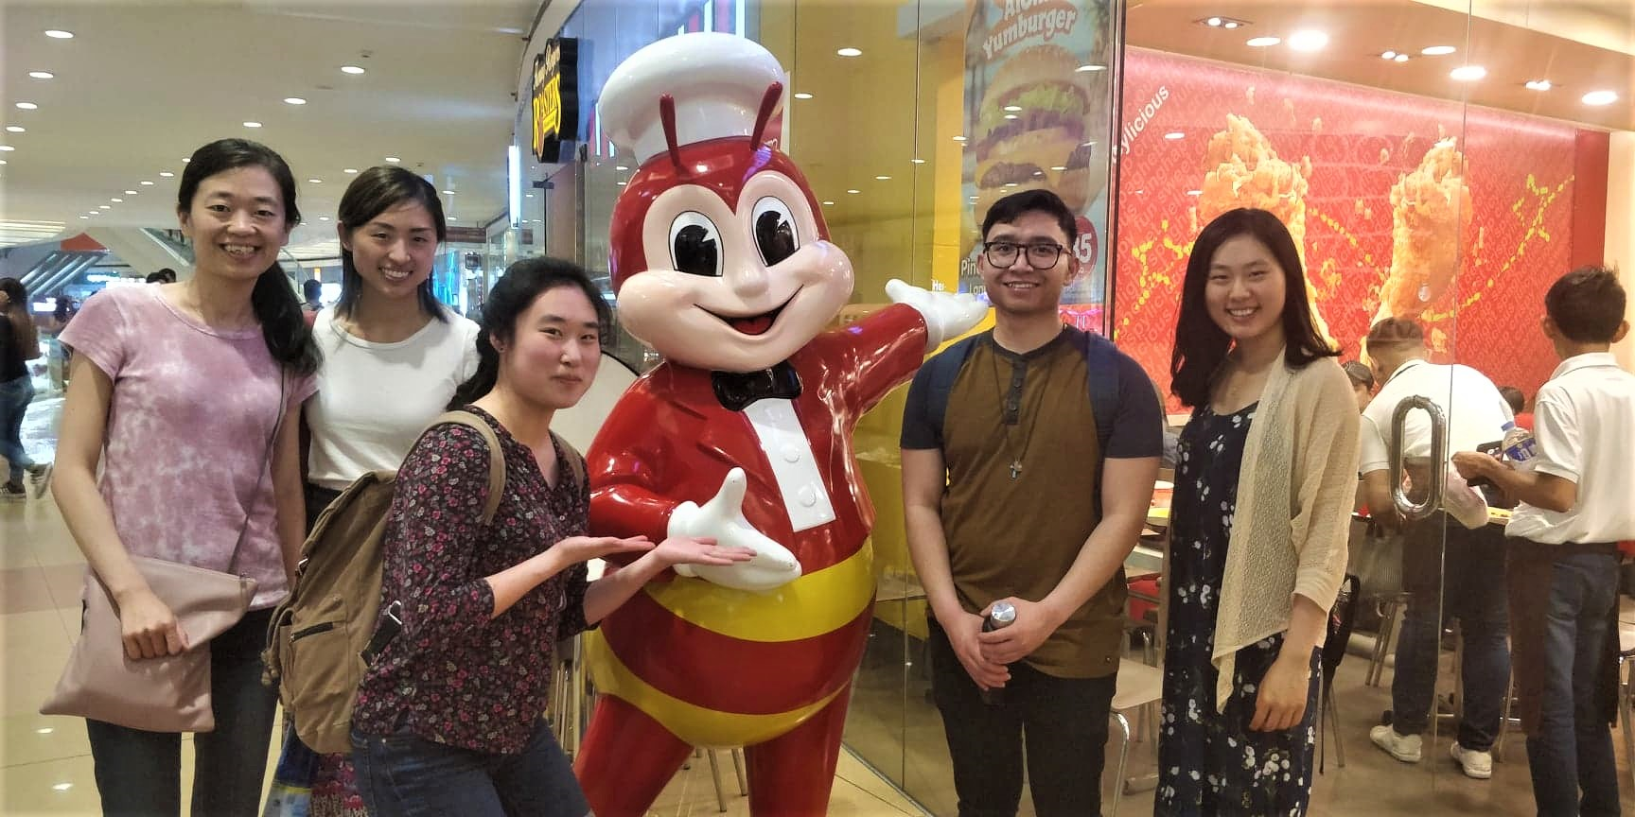

Slide 15
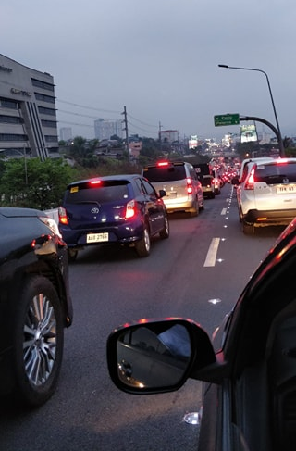
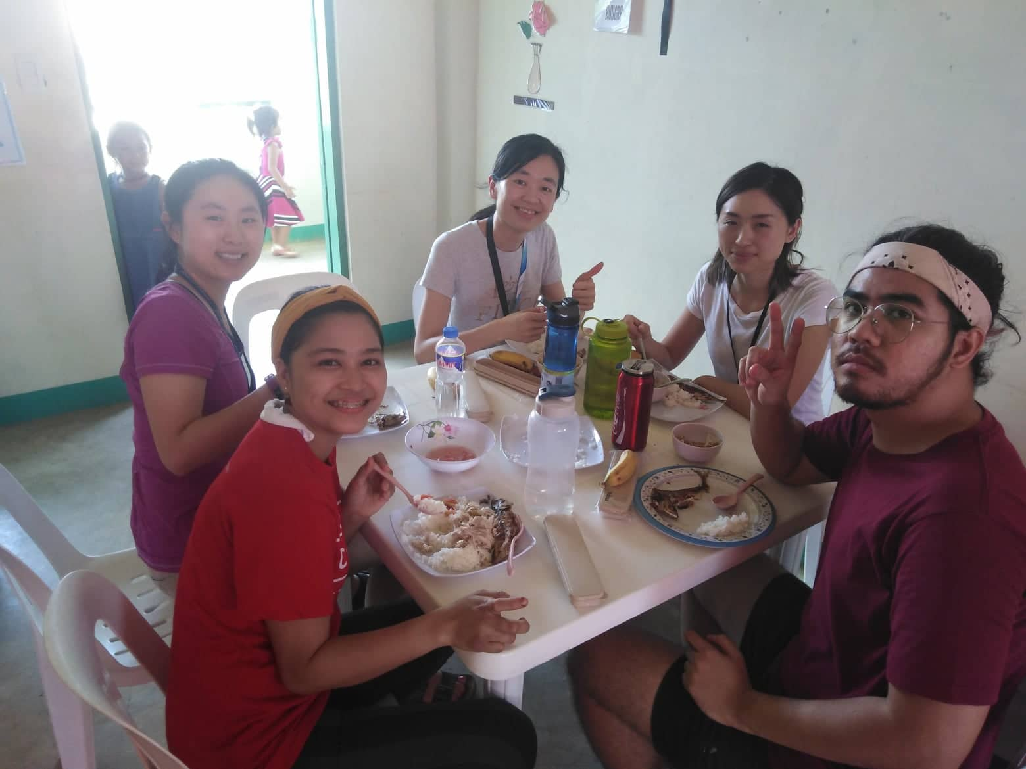

Slide 16
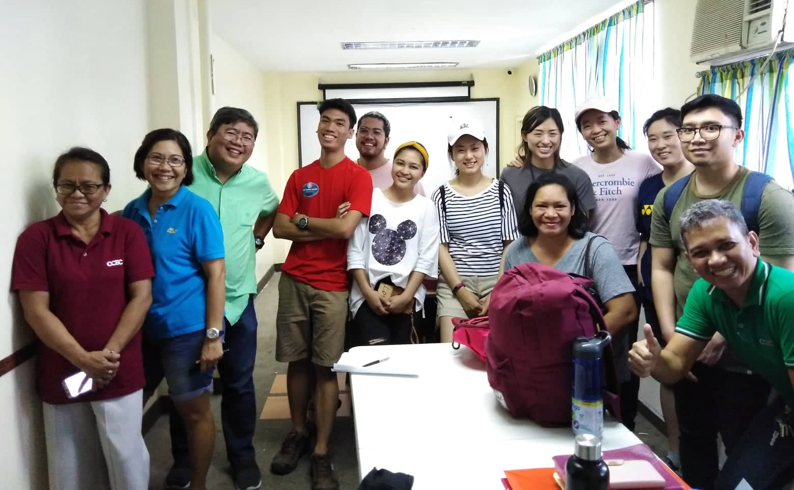

Slide 17
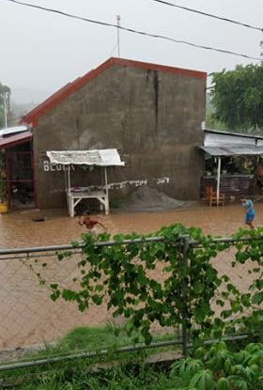
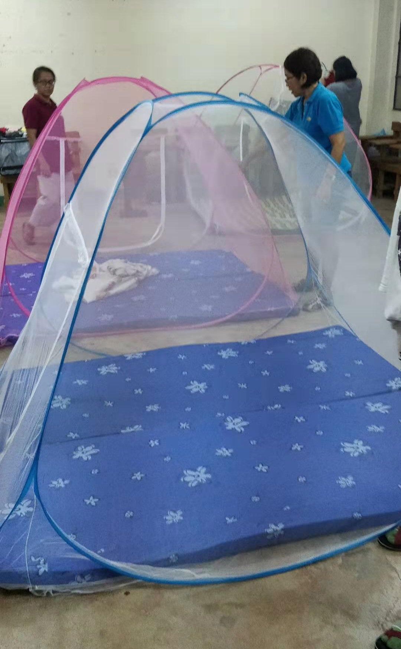

Slide 18
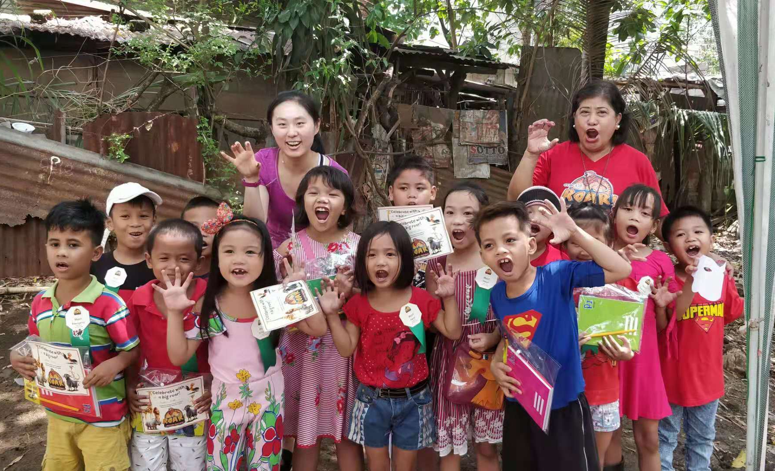

Slide 19
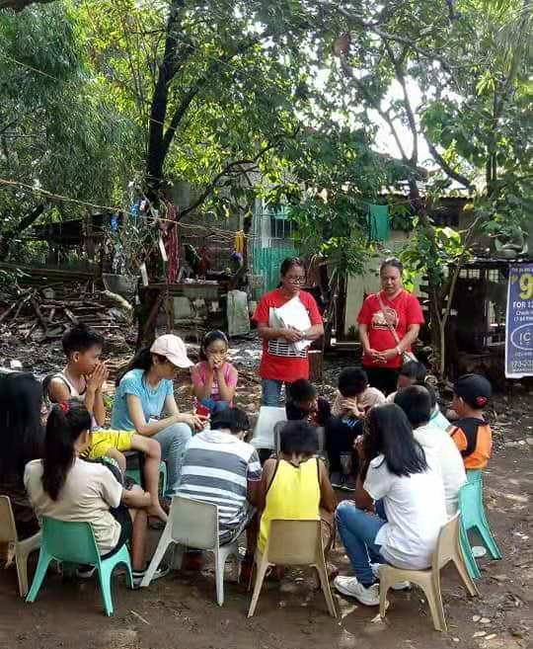
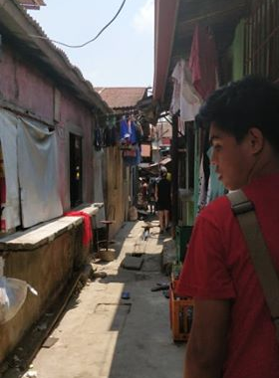
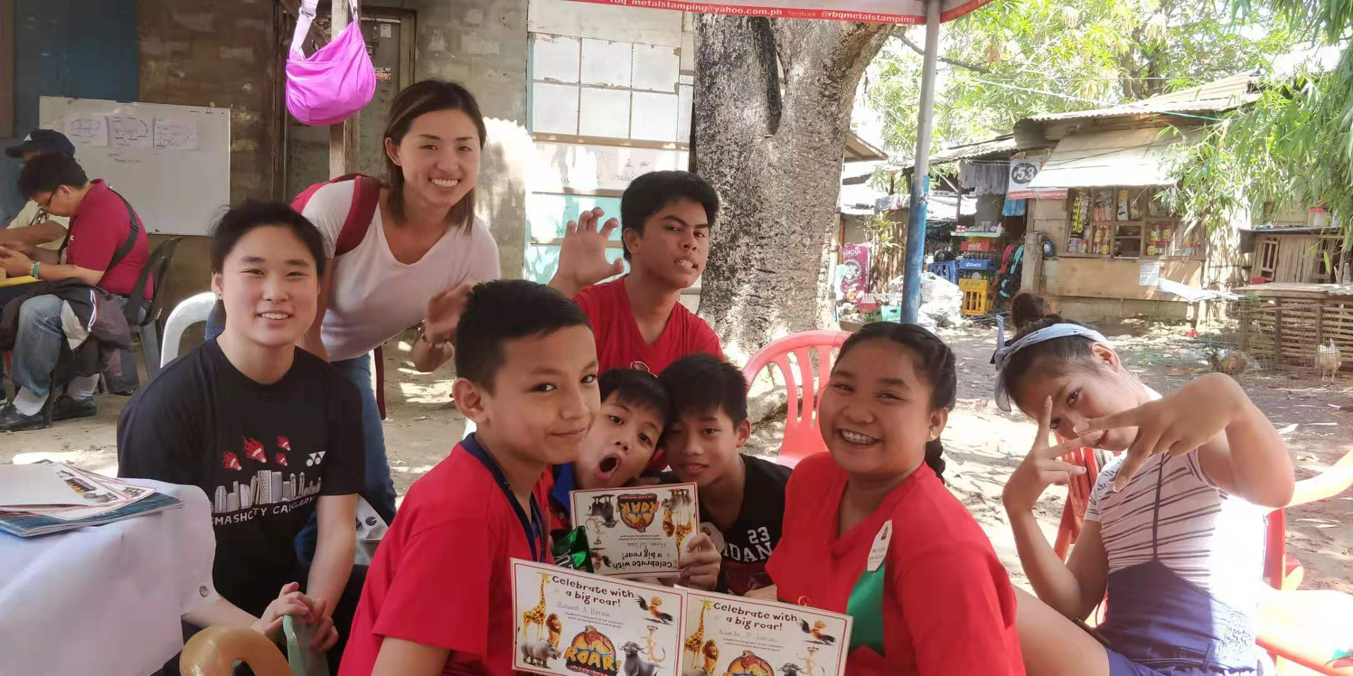

Slide 20
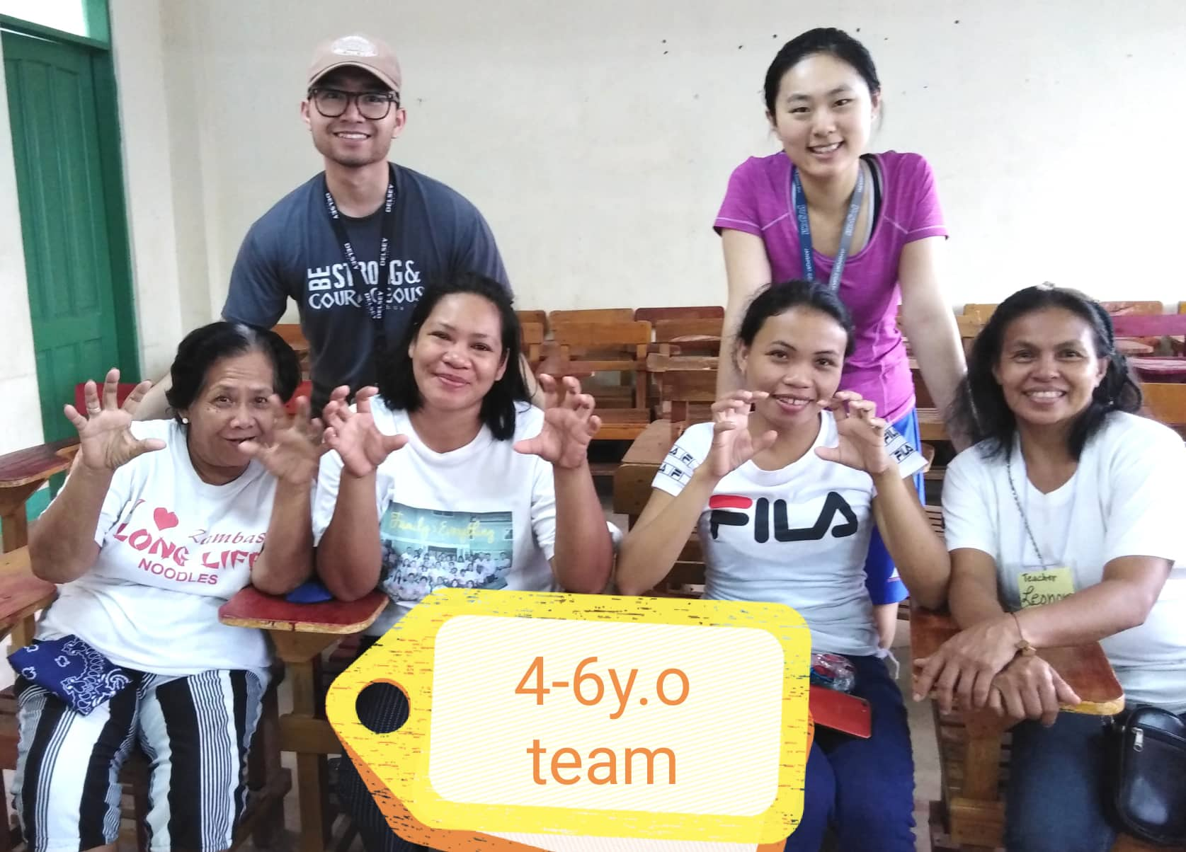

Slide 21
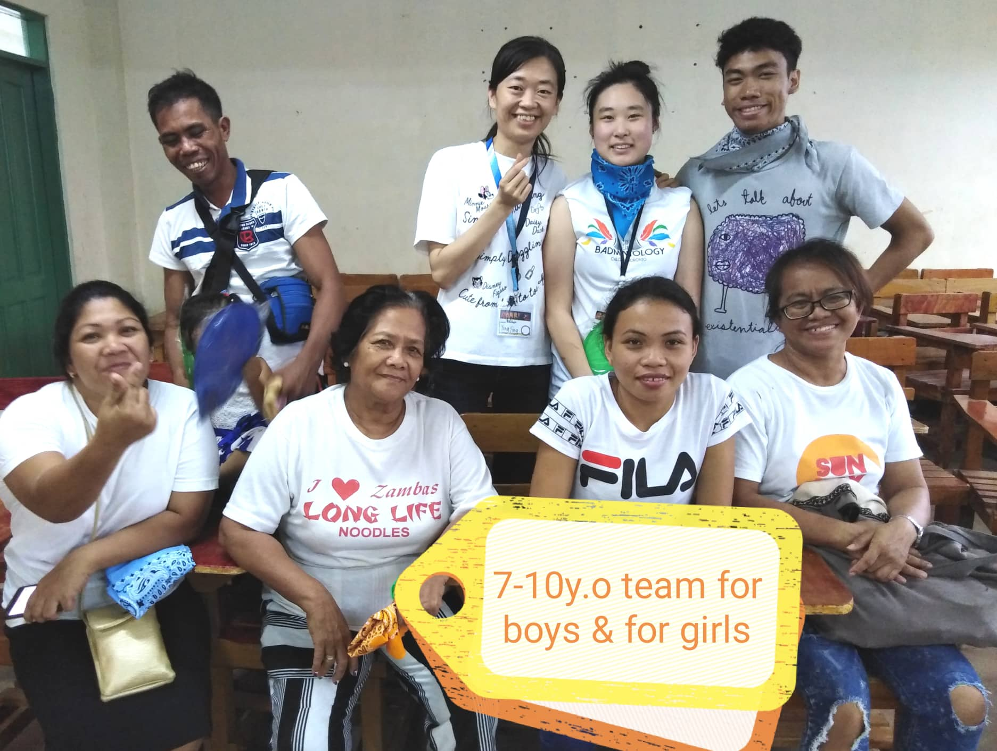

Slide 22
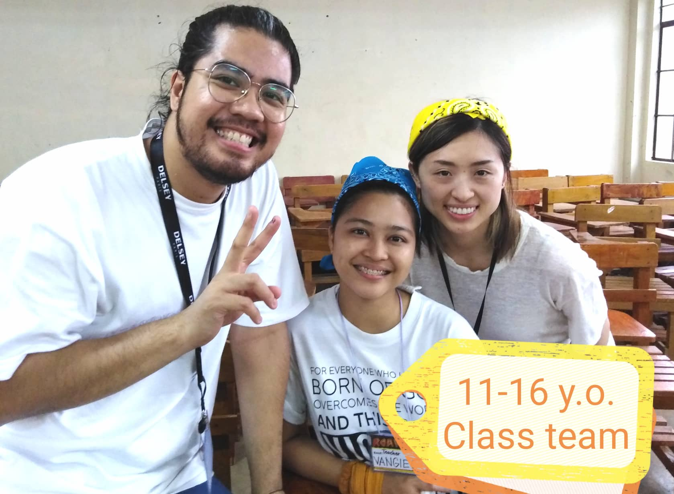

Slide 23
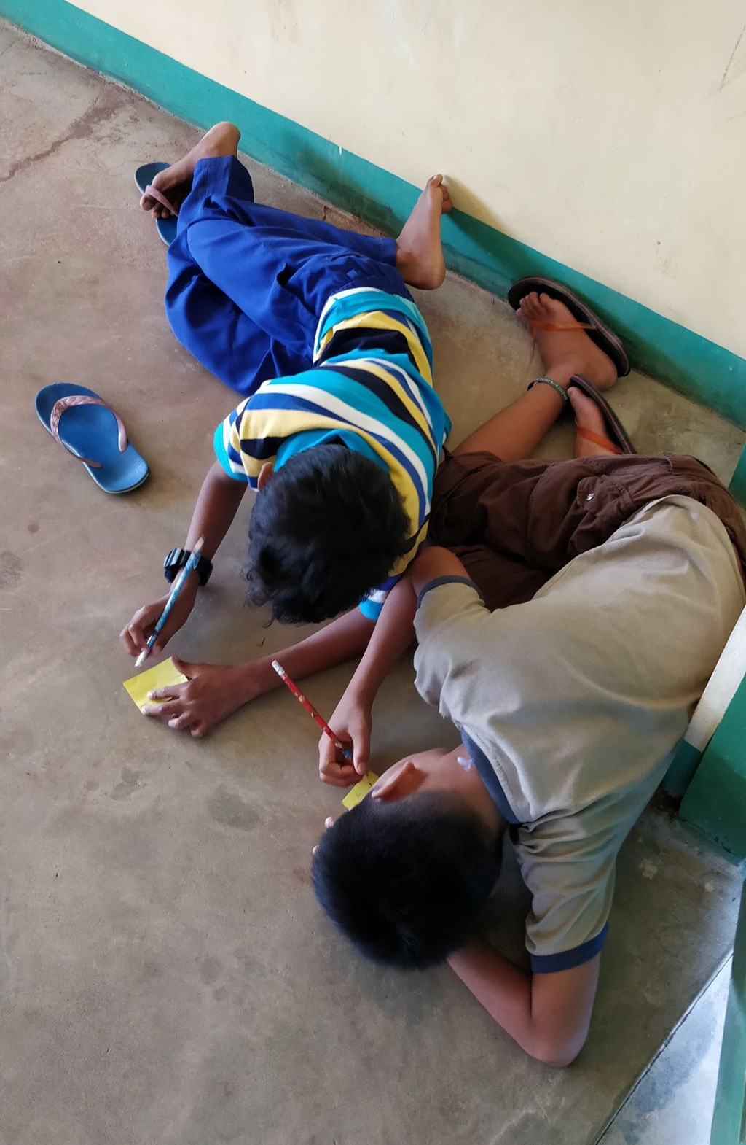
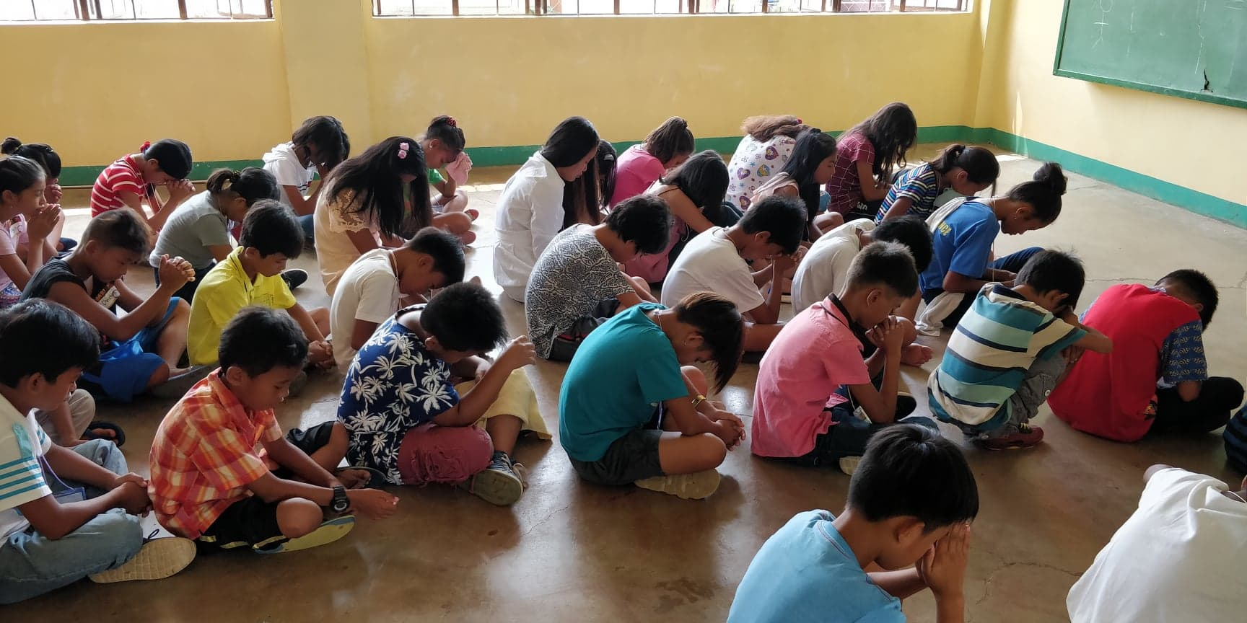

Slide 24
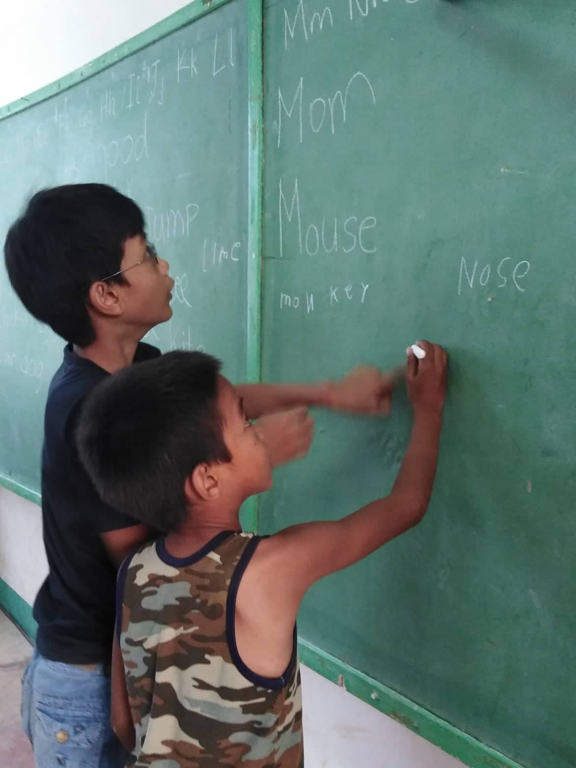
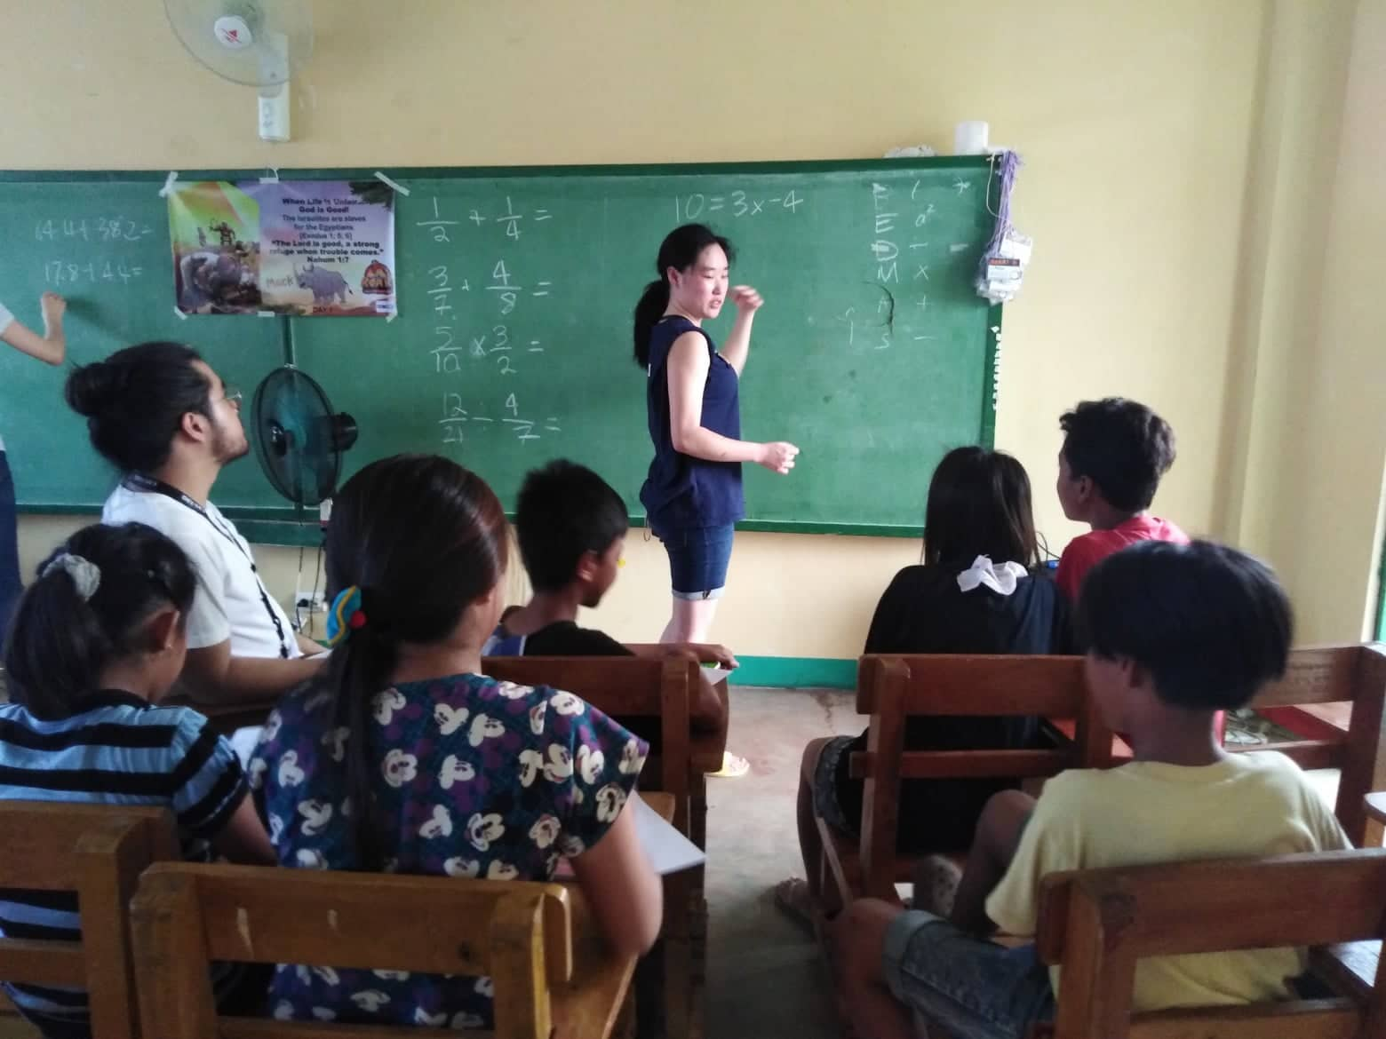

Slide 26
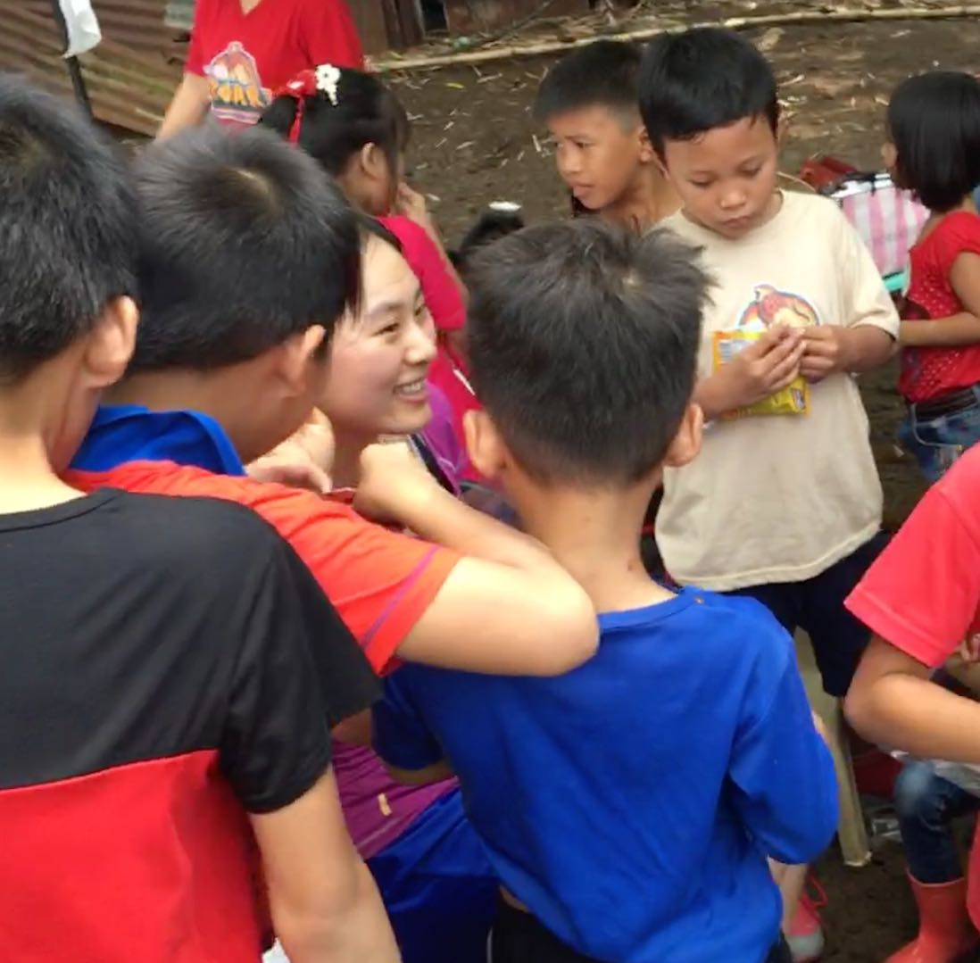
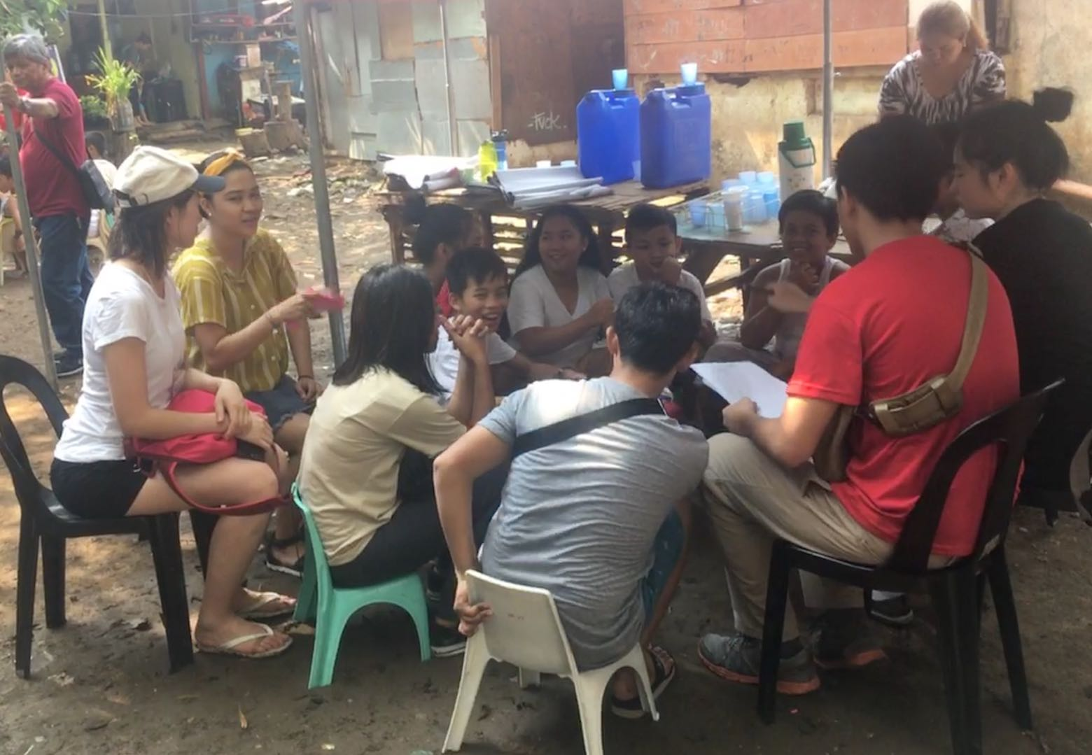
ROOTS PHILIPPINES PROJECT
MANILA

Slide 27
ROOTS PHILIPPINES PROJECT
MANILA

Slide 28
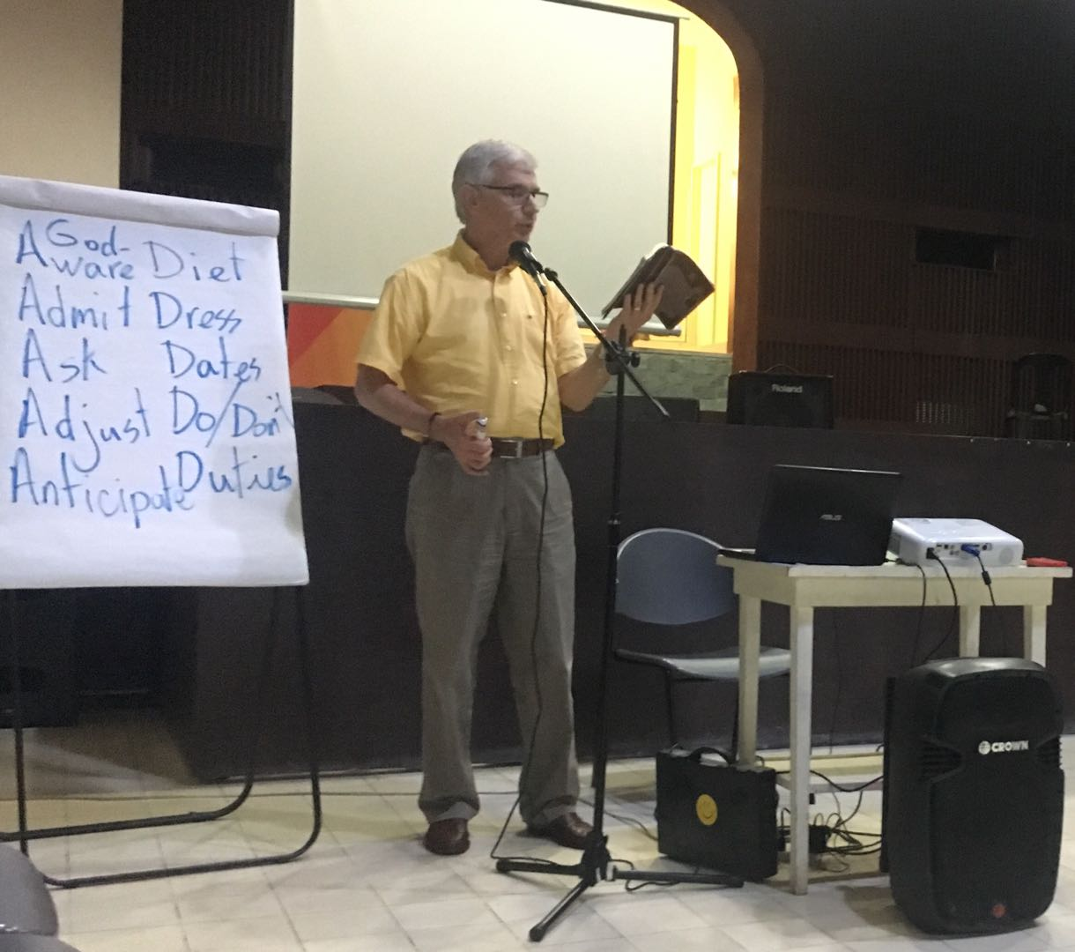
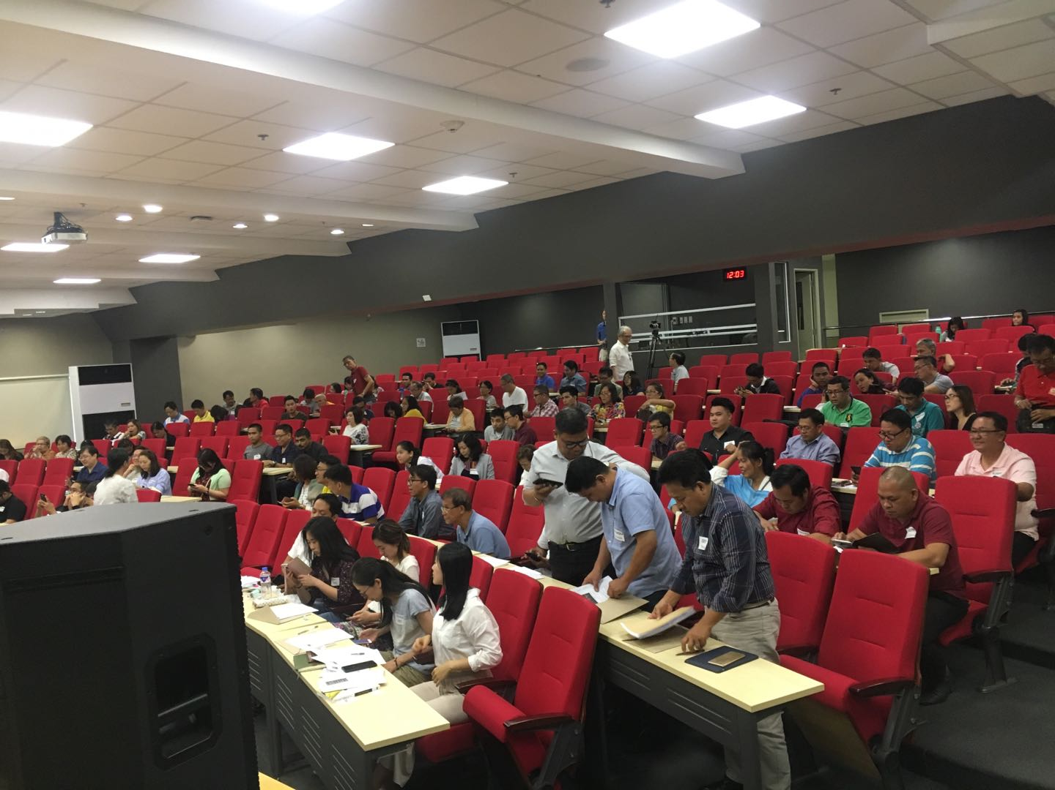
ROOTS PHILIPPINES PROJECT
MANILA

Slide 29
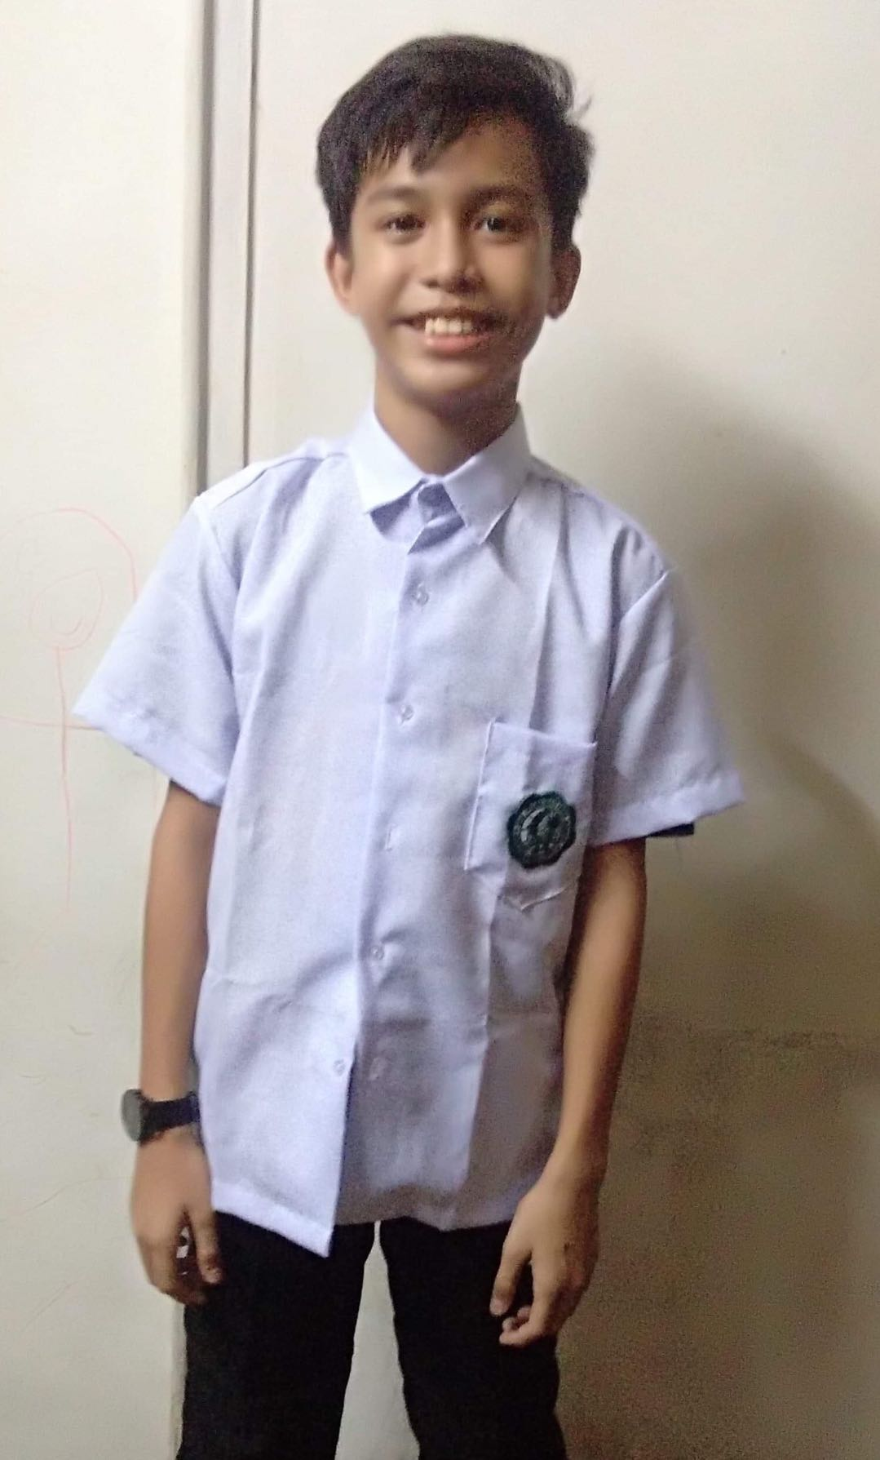
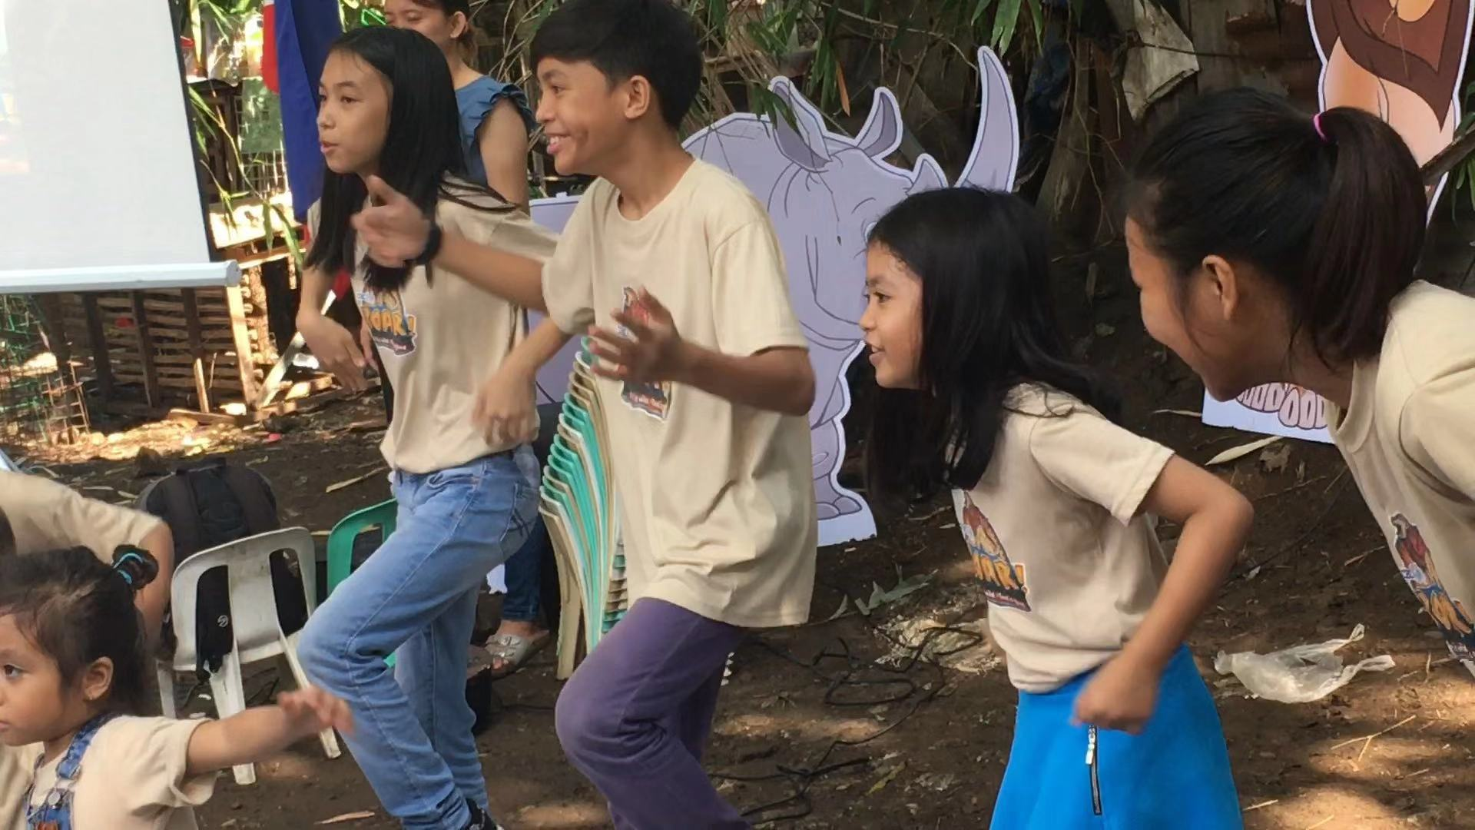
ROOTS PHILIPPINES PROJECT
MANILA

Slide 30
ROOTS PHILIPPINES PROJECT
MANILA

Slide 31
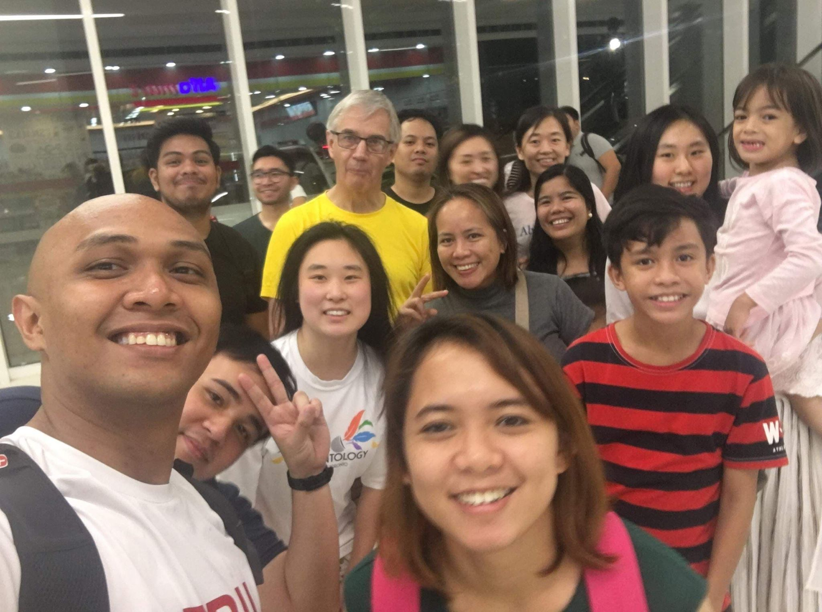
ROOTS PHILIPPINES PROJECT
MANILA
Gerda
Niel

Slide 32
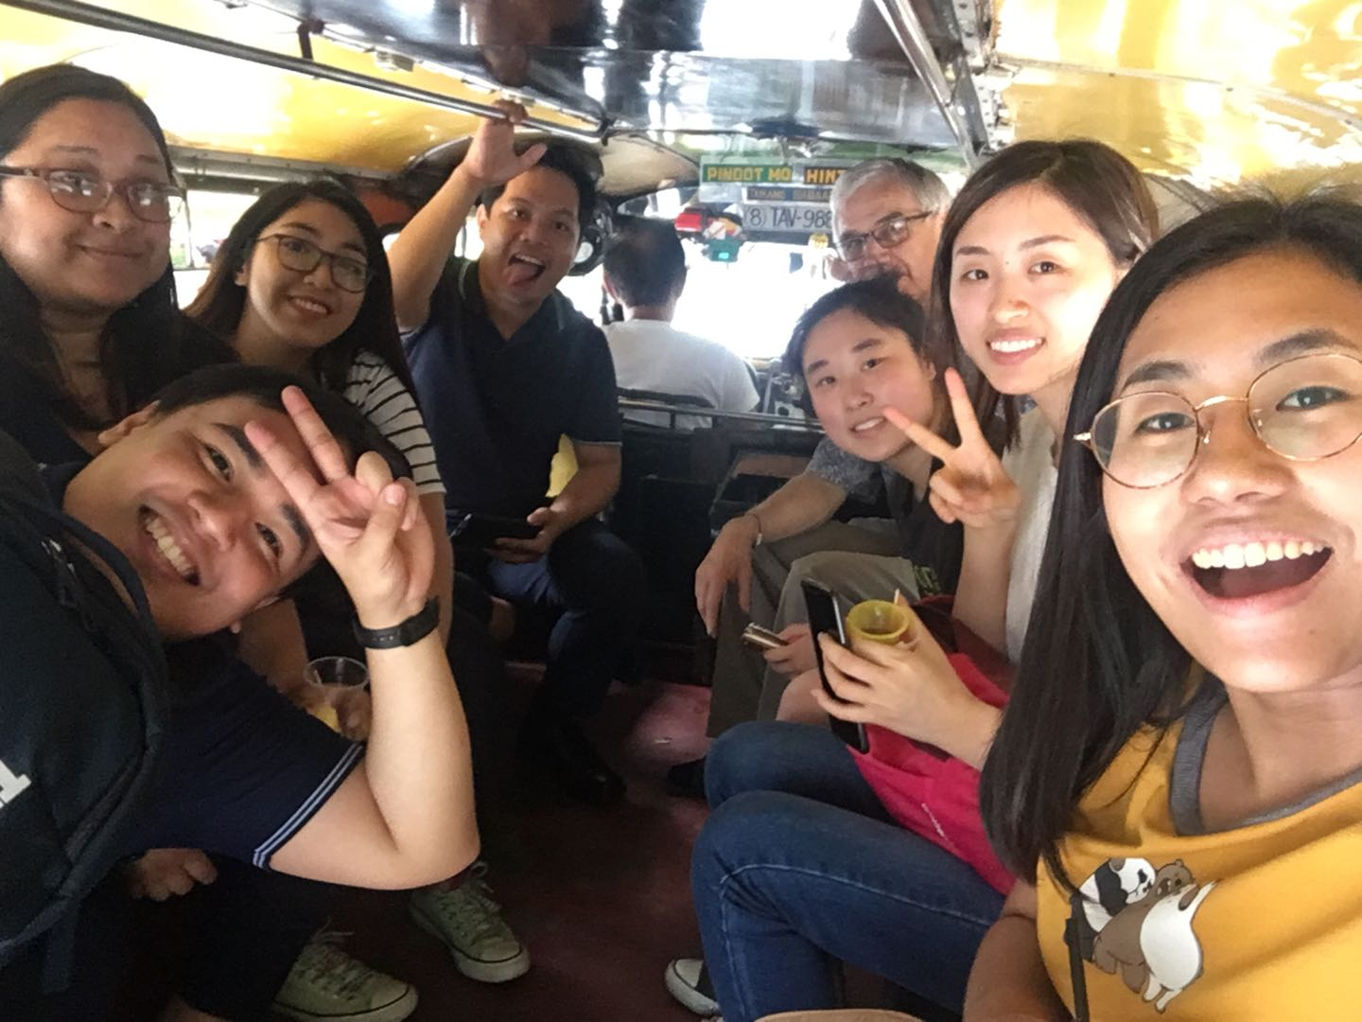
ROOTS PHILIPPINES PROJECT
MANILA
“John”

Slide 33
ROOTS PHILIPPINES PROJECT
Whoever conceals their sins does not prosper, but the one who confesses and renounces them finds mercy. (28.13)
遮掩自己过犯的，必不亨通；承认并离弃过犯的，必蒙怜悯。(箴言 28:13)
MANILA

Slide 34
GenSend Summer North American Mission Board
Susan Guo

Slide 35
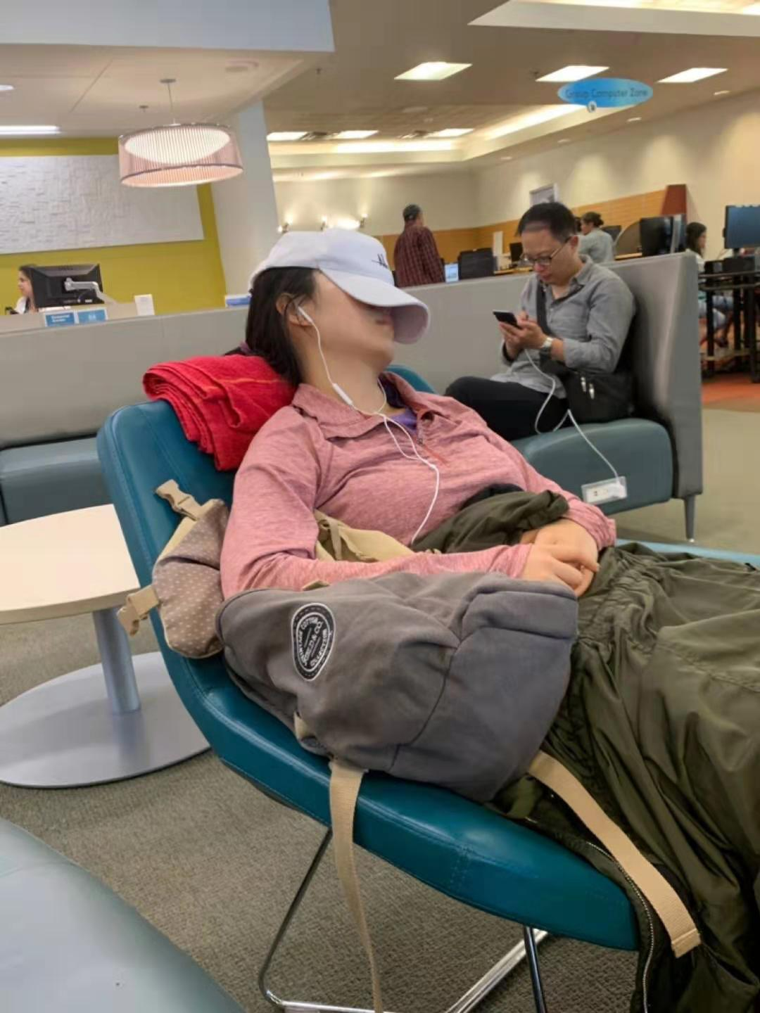
God, help me!
主啊啊啊！

Slide 36
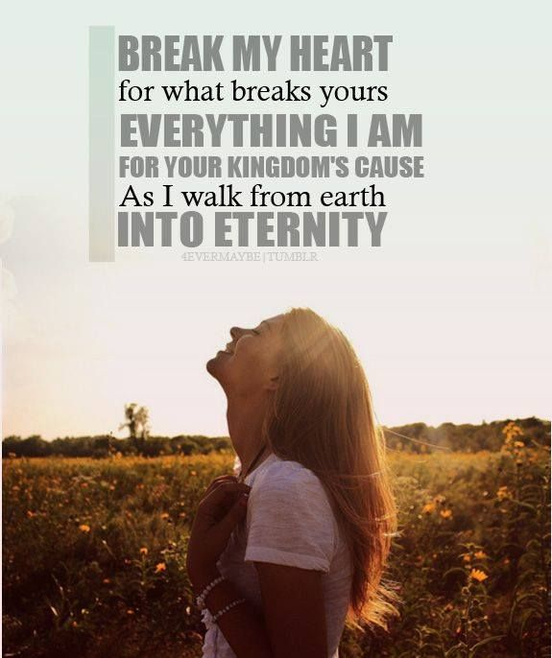

Slide 37
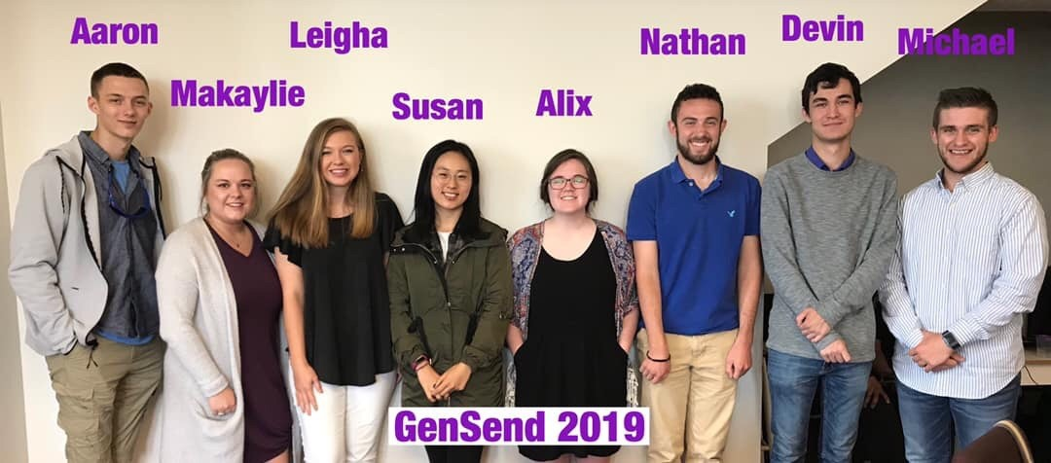
Living Life on Mission
Joining the everyday mission of God

Slide 38
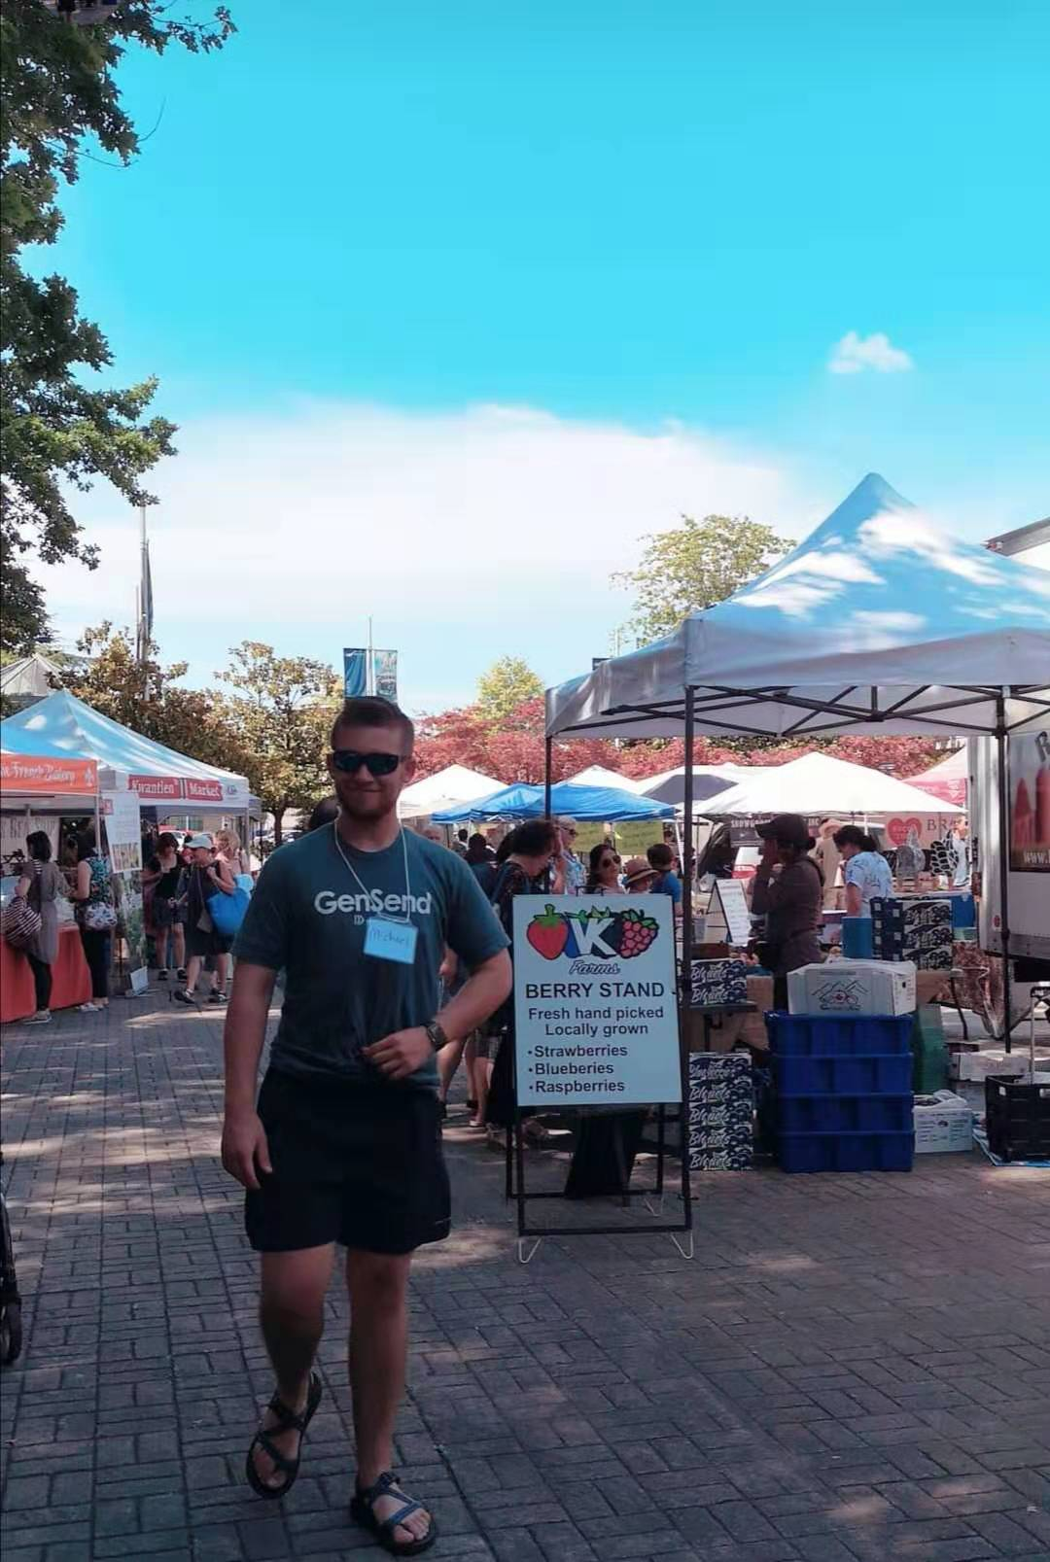
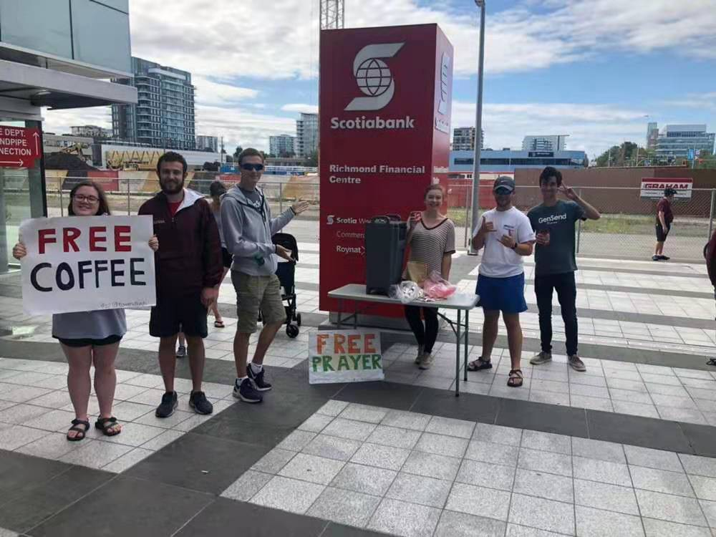

Slide 39
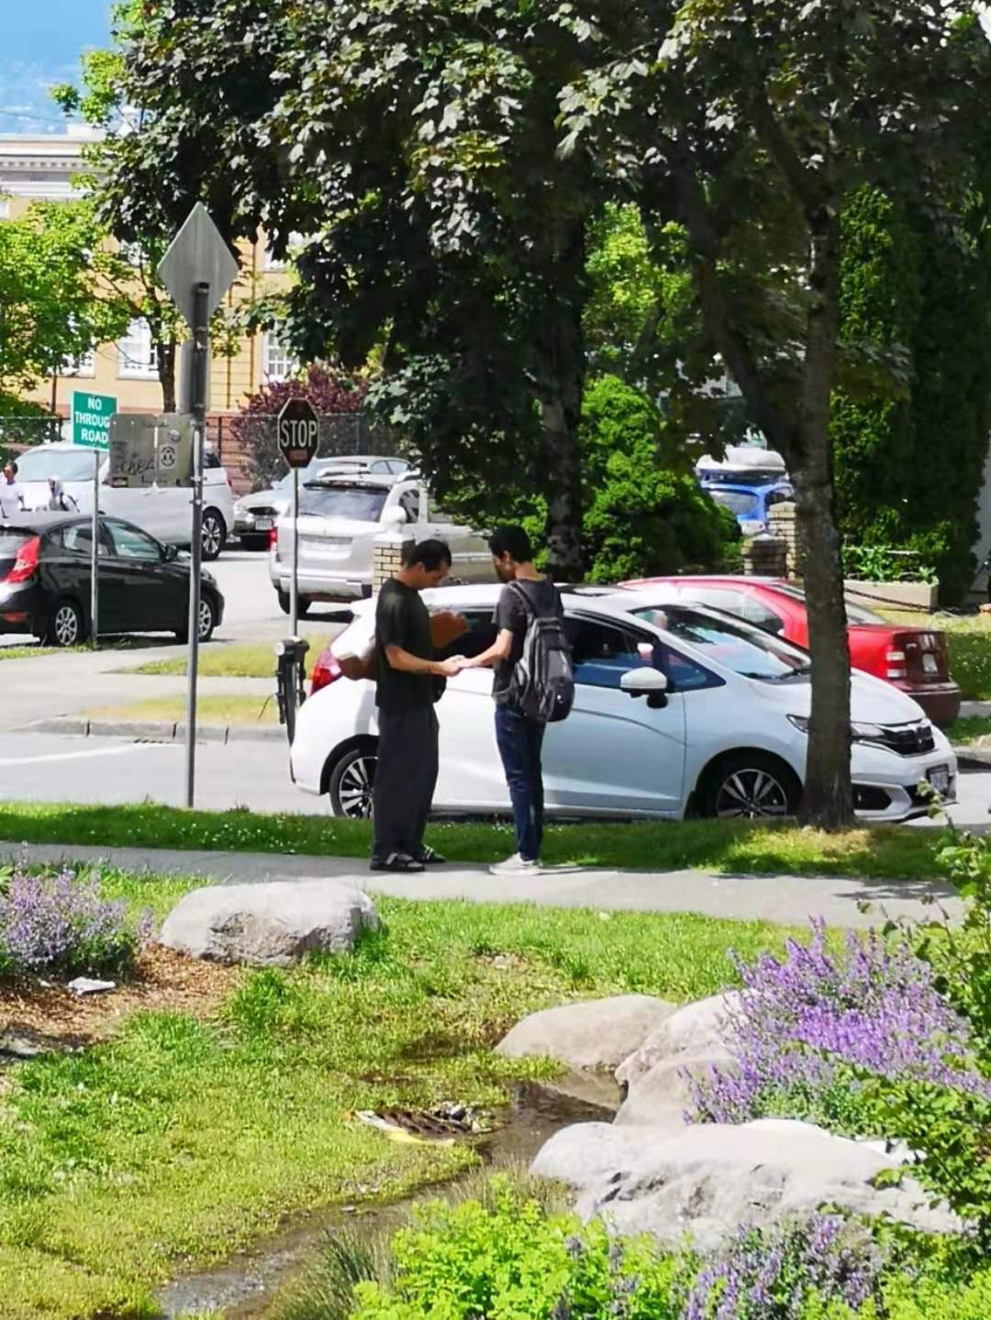
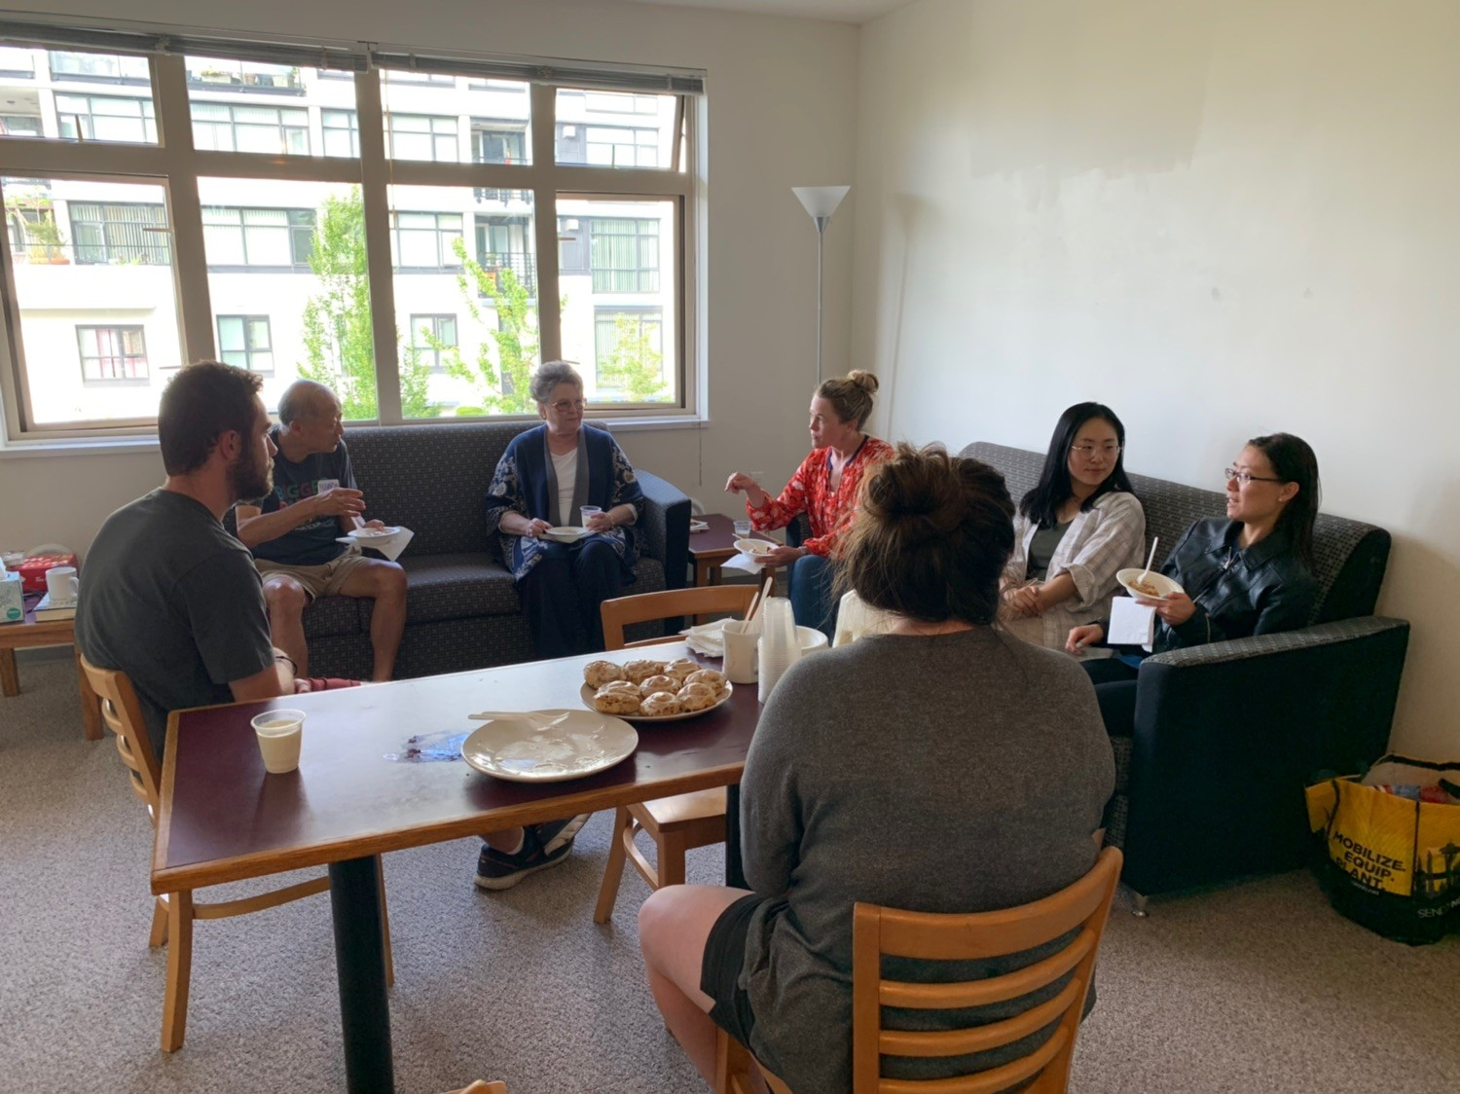

Slide 40
1 Corinthians 10:31
“³¹ So, whether you eat or drink, or whatever you do, do all to the glory of God.”
^{“31} 所 以 ， 你 们 或 吃 或 喝 ， 无 论 做 甚 麽 ， 都 要 为 荣 耀 神 而 行 。”

Slide 41
Vancouver was named the third best city in the entire world for quality of life standards for 2019

Slide 42
97% of 2.8 million in the Greater Vancouver Area are far from God… that’s around 2.7 million people!

Slide 43
Living Life on Mission
Joining the everyday mission of God
Matthew 28: 19 – 20
“¹⁹ Therefore go and make disciples of all nations, baptizing them in the name of the Father and of the Son and of the Holy Spirit, ²⁰ and teaching them to obey everything I have commanded you. And surely I am with you always, to the very end of the age.”
“ ¹⁹ 所 以 ， 你 们 要 去 ， 使 万 民 作 我 的 门 徒 ， 奉 父 、 子 、 圣 灵 的 名 给 他 们 施 洗 （ 或 作 ： 给 他 们 施 洗 ， 归 於 父 、 子 、 圣 灵 的 名 ） 。
²⁰ 凡 我 所 吩 咐 你 们 的 ， 都 教 训 他 们 遵 守 ， 我 就 常 与 你 们 同 在 ， 直 到 世 界 的 末 了 。”

