Slide 2
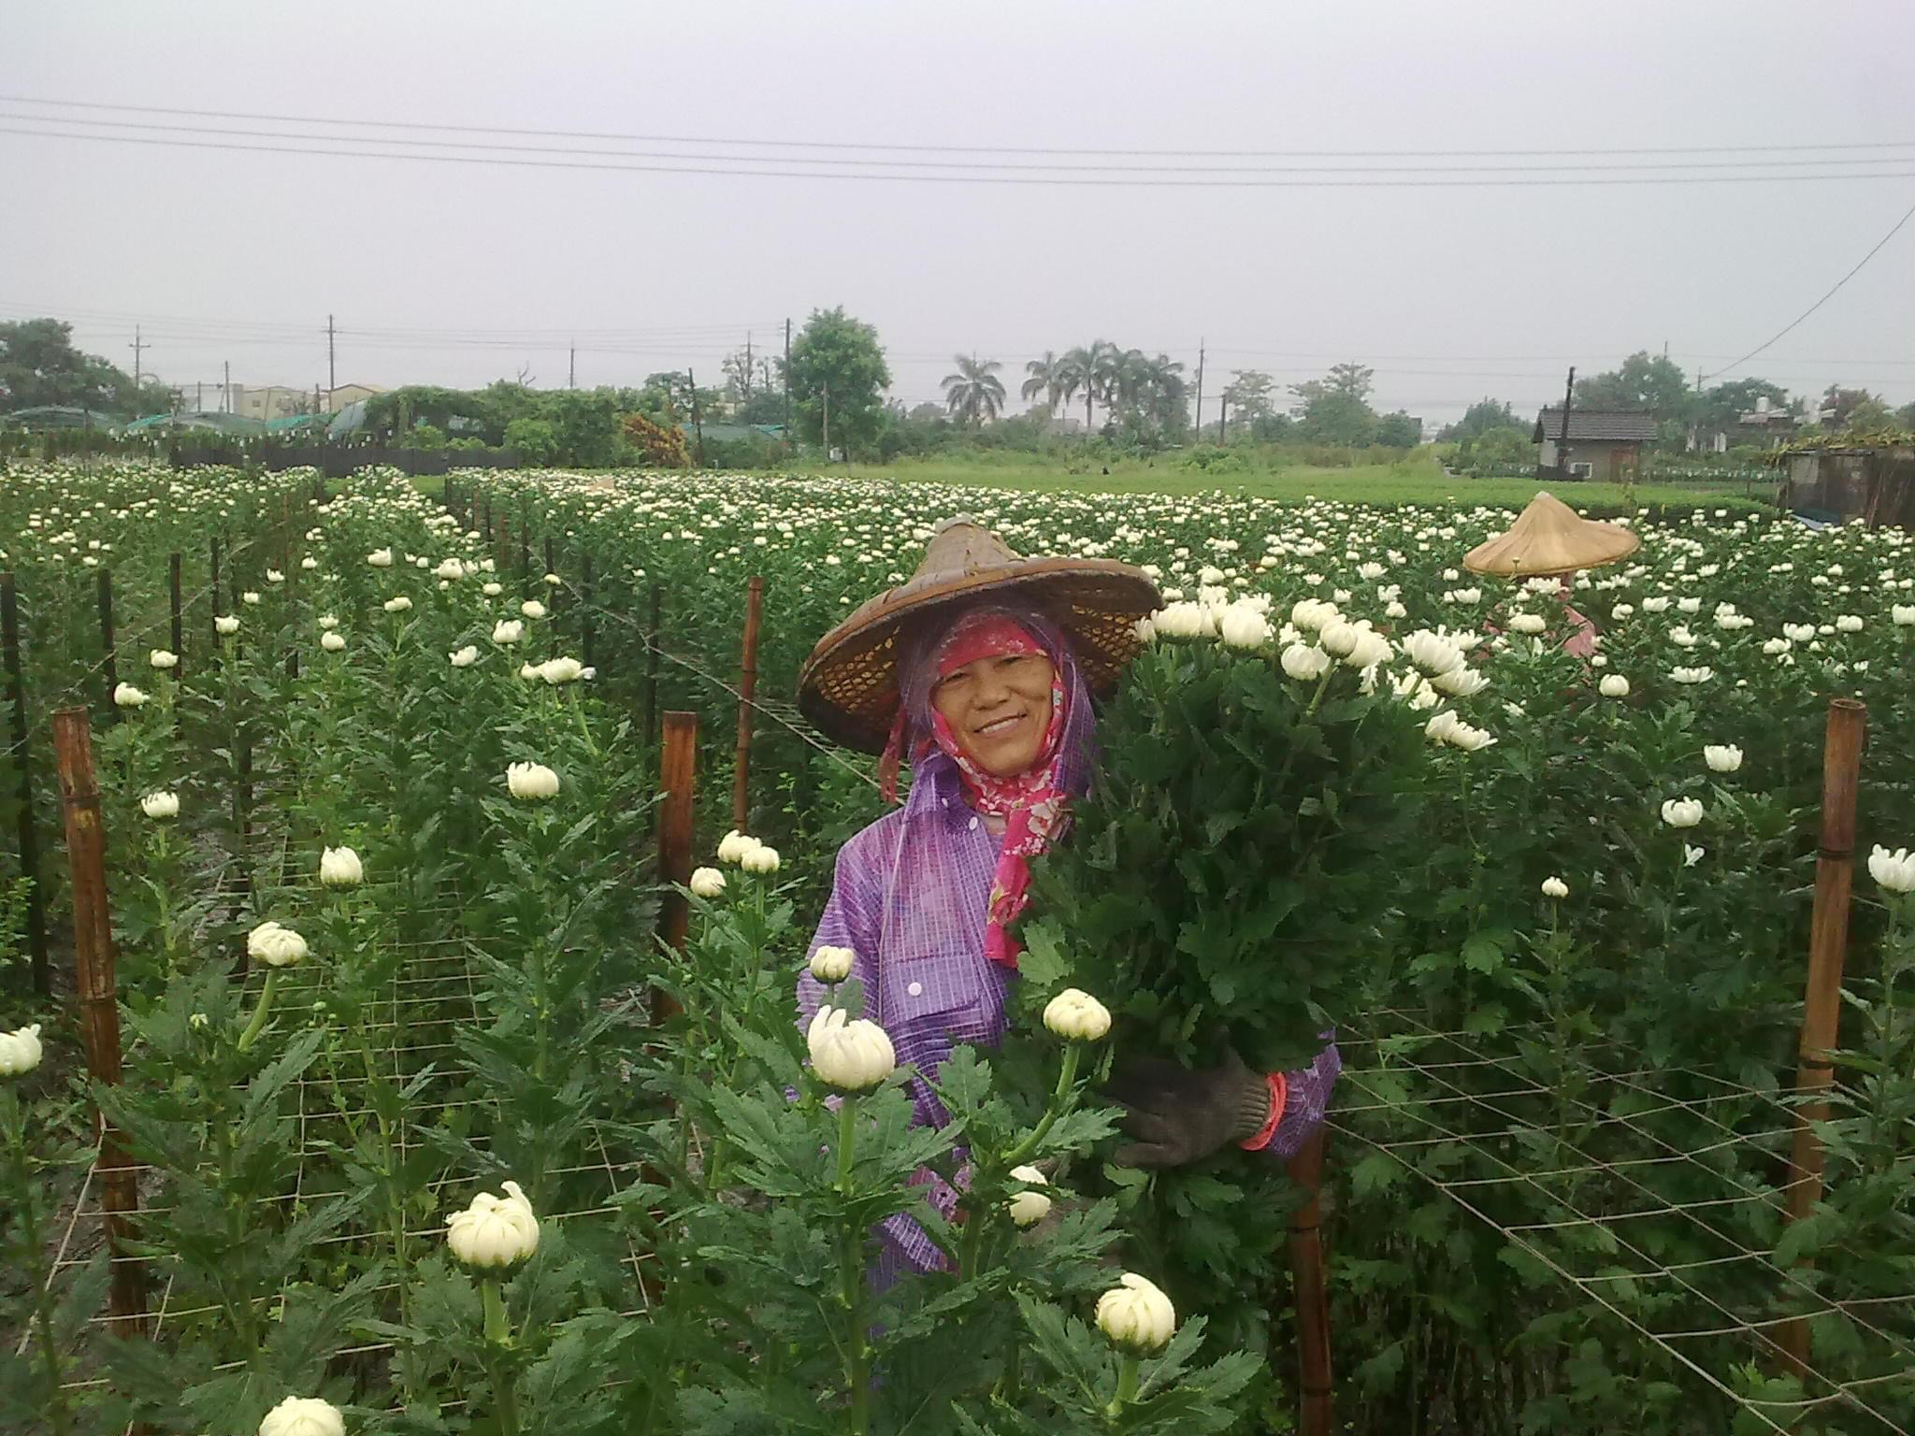

Slide 4
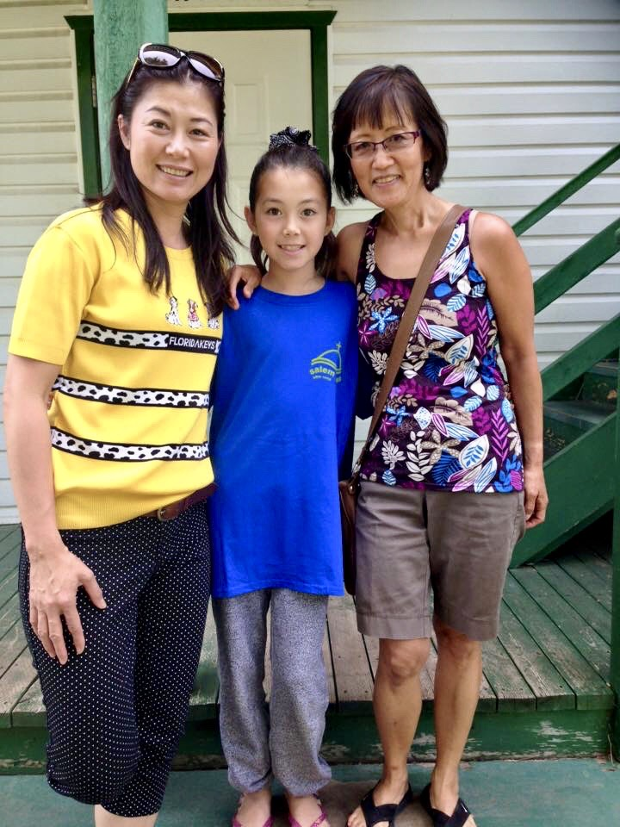

Slide 6
Amanda’s Baptism

Slide 8
